Slide 1
IO8 – plans and ideas
VSA
07.07.2022
Athens

Slide 2
1) What is gamification?
The process of incorporating psychologically motivating elements and mechanisms present in games into a non-game environment
Objective: more interesting and effective
Areas: workplace, health care, culture or education – positive effects
Can be implemented with great success in areas that are particularly difficult/demanding and/or where first-hand experience is not available or difficult to obtain
Motivating participants, facilitating development/learning processes, overcoming difficulties
Keeping interest for a longer time period, greater sense of achievement
Benefits: playfulness, game elements ("everyone likes to play") make the user (prisoner, pre-release, members of the majority society, etc.) more motivated, reduced stress level (e.g. simulation)
Immediate feedback
Competence development (communication, the ability to obtain and use information, decision-making, problem-solving, etc.) cooperation skills
Games provide opportunities for participants, even of different ages, educational backgrounds or competences, to learn from each other, to participate together in a common activity, as is the case in real life ("community learning", i.e. learning based on community interaction). → responsibility, attention to each other

Slide 3
2a) Change Fever board game
A board game for the preparation for release
Based on the first 30 days of release, with post-release tasks to be completed in life ("missions").
Board game, card game, role-playing game and alternative reality game
Can also be used for sensitisation
Played in a group (4-6 players), with the interaction between the game leader and the group members
The game can be used in several sessions

Slide 4

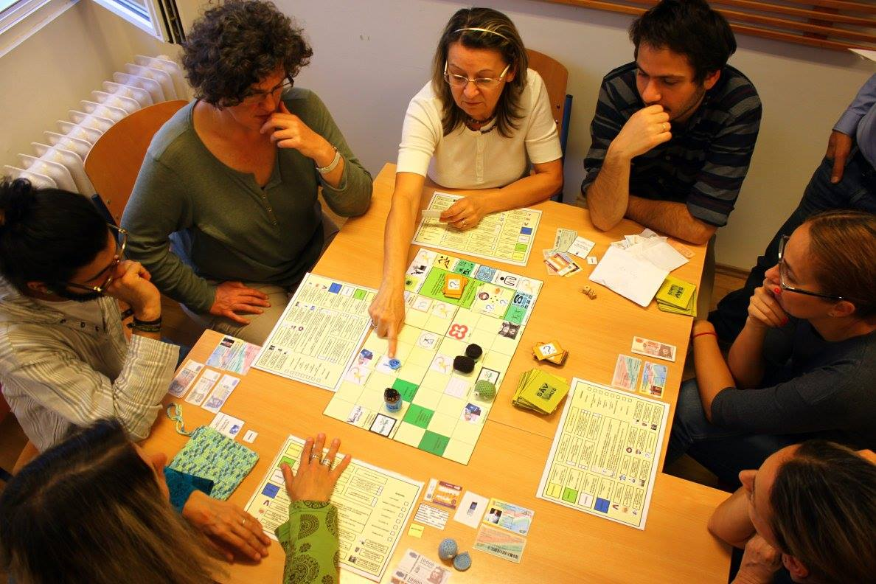
2b) Development process
Significant change in the professional work of our organisation + the prison population has changed
Prisoners with lower competences
Early 2000s: Practical Knowledge on Release publication - reviewed and updated annually.
Later: pictograms, visual cues → better comprehension
Gamification → Change Fever board game: tested and played in a professional environment (prison stuff, prisoners, professionals)

Slide 5
2c) Methodological innovation
In the reintegration, in the preparation for release, the gamification methodology and the use of the existing board game is undoubtedly an innovation. Prisons are also open to this, and over the years many prison professionals have become acquainted with the game, played it and tested it. A shorter training course for game masters is needed to make the game applicable.

Slide 6
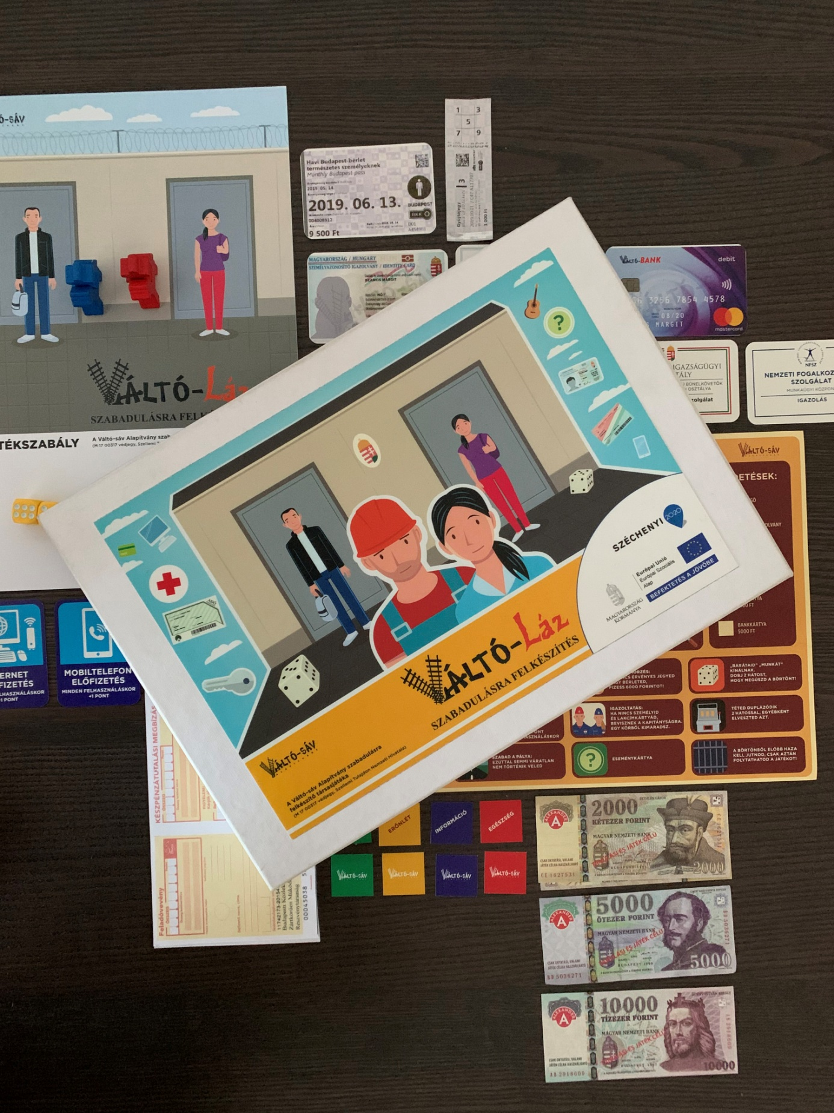
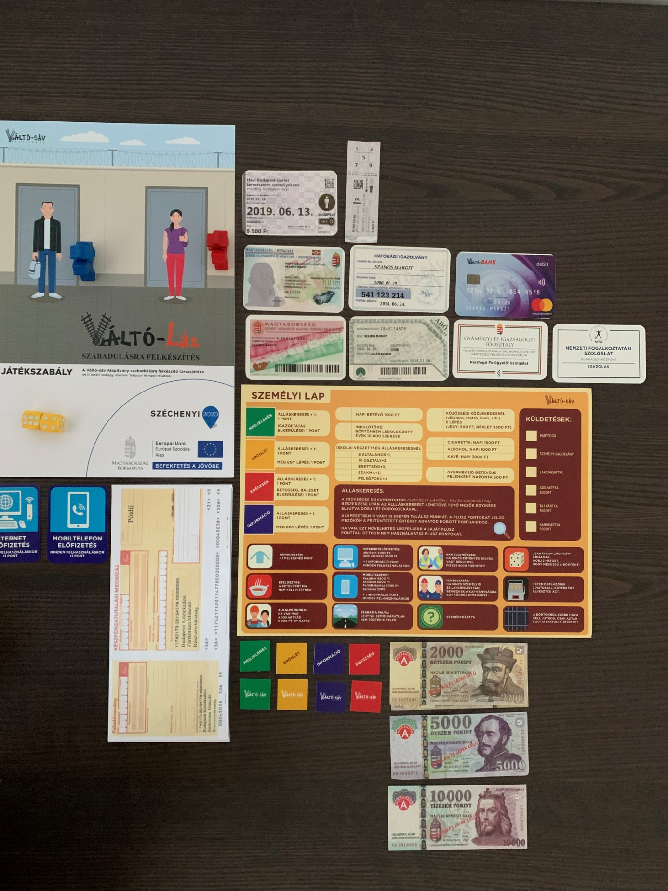
3) The game itself, rules

Slide 7
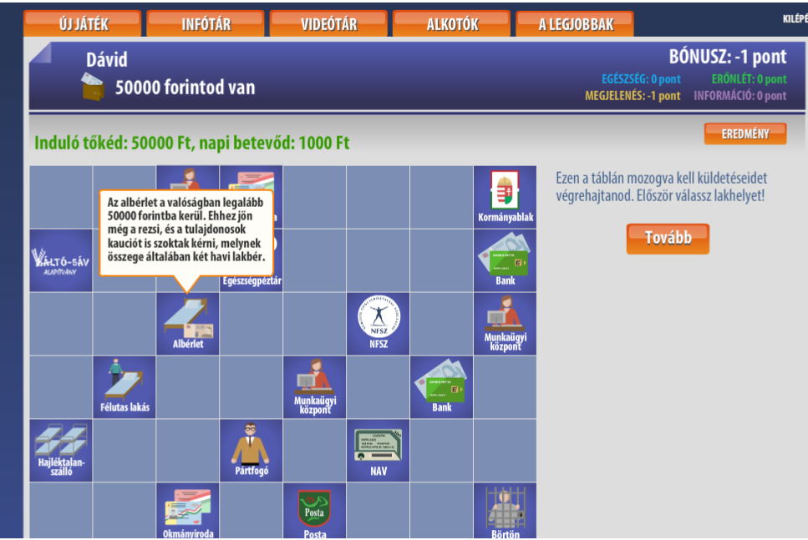
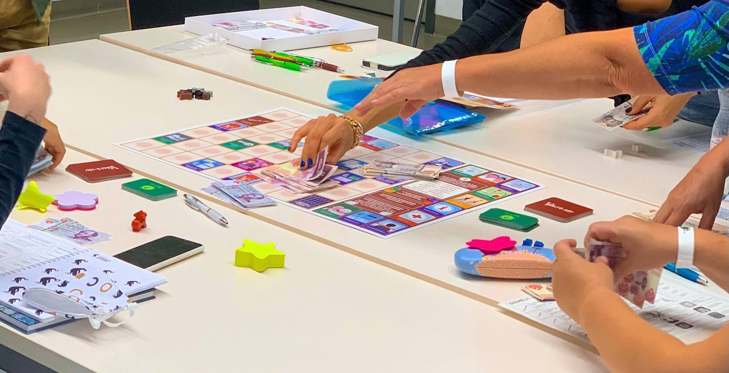
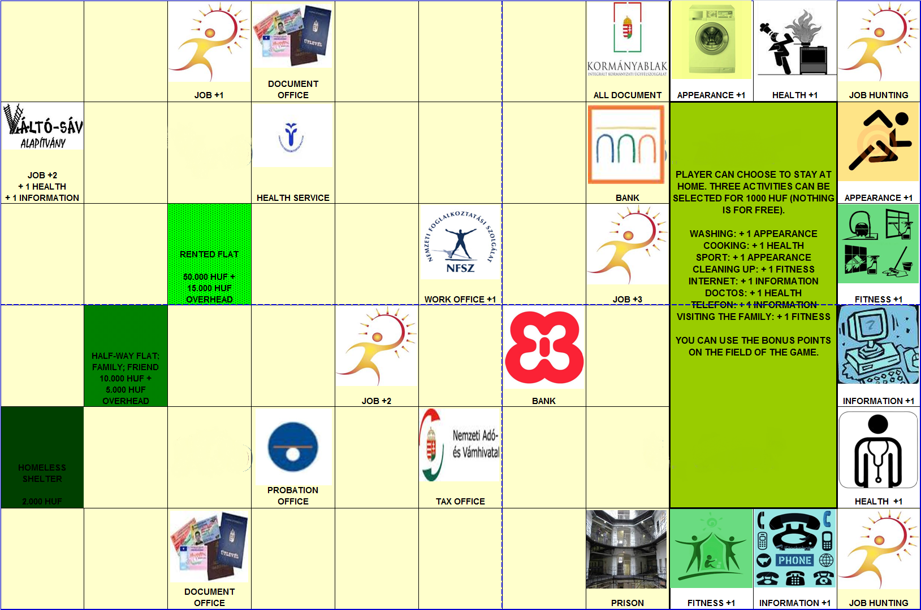
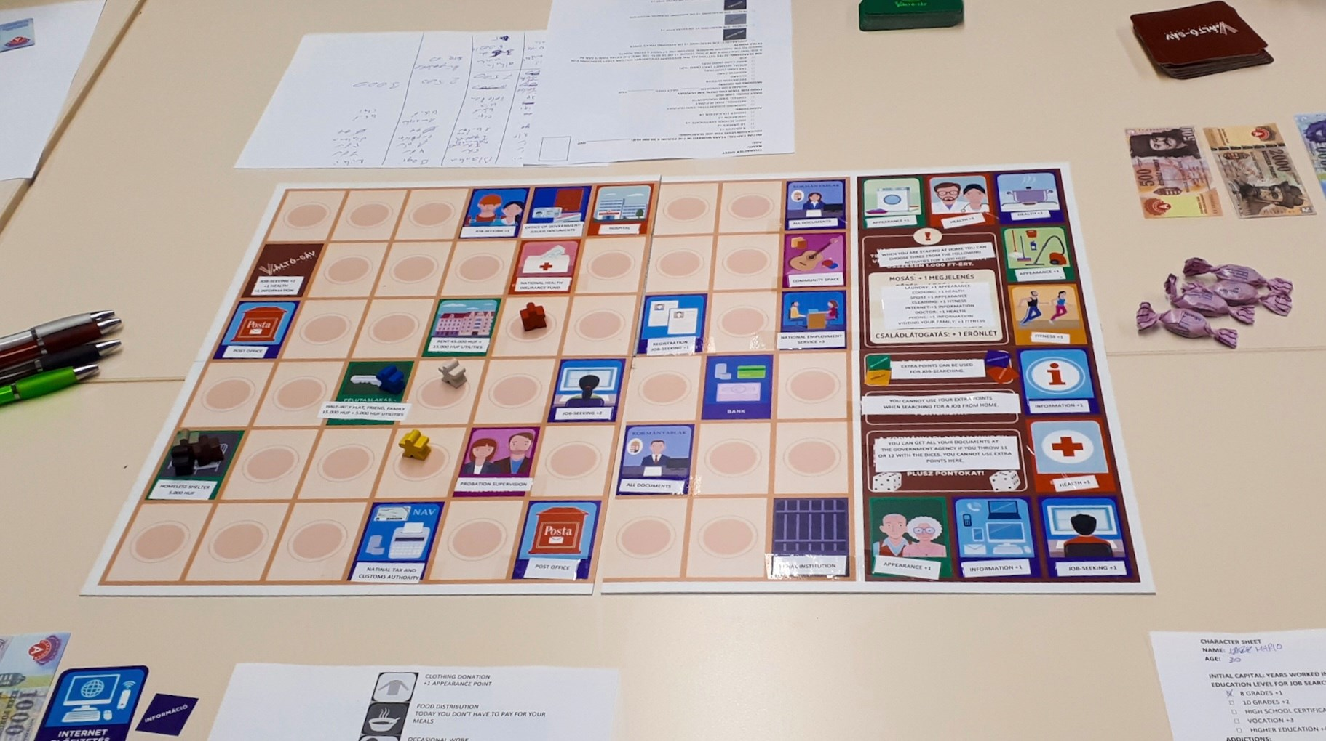

Slide 8
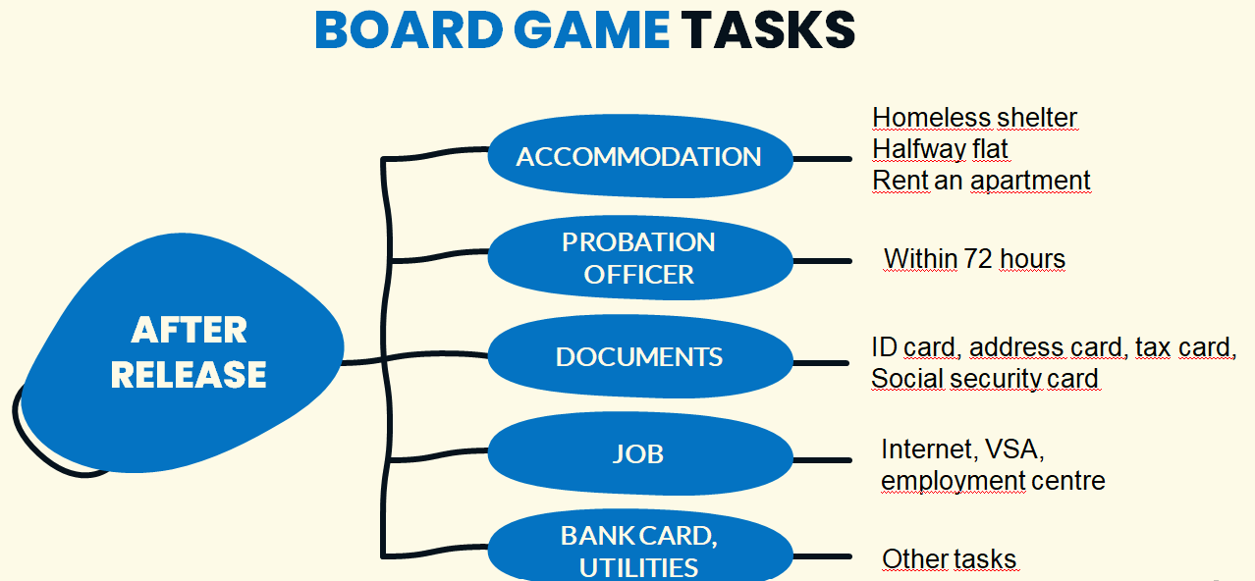

Slide 9
4) Methodological training for professionals
1-day-training, 8-10 participants
Explore and learn about approaches, tools, methods, techniques to develop the competences of professionals and/or facilitators working in the field of reintegration
Personal experience with the gamification method
Phase 2: professionals start the use of gamification in their own prison – mentoring (at least once).
Phase 3: 1 day group closing, evaluation, summary (duration: 4 hours)

Slide 10
Thank you for your attention

