Slide 1


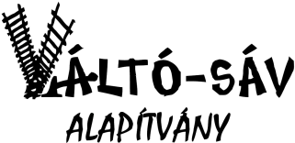



UNLOCKED PROJECT
IO1:
Ways of using art therapy Studies /analyses - Best practice guidelines report
24-25 June, 2021
1st International Meeting in Budapest,
Hosted by Váltó-sáv Alapítvány
Niovi Stavropoulou (MSc), Art Therapist - Psychologist
Loukia Chaidemenaki (MSc), Art Therapist - Psychologist

Slide 2
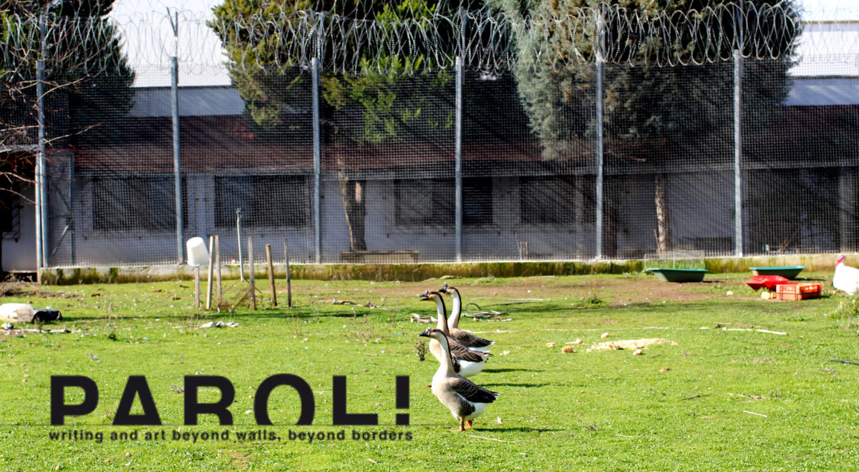
Thiva 102 km is part of the project PAROL which aimed to create a bridge of communication between European prisons and societies through Art.
AMAKA implemented phototherapy workshops within the prison of Thiva for women inmates. It is used as a good practice and is displayed as a case study in IO1.

Slide 3
METHODOLOGY
MULTIMODAL ART THERAPY
NEW MEDIA & PHOTO ART THERAPY
EXPRESSIVE ART THERAPY
ART AS THERAPY
DRAMA THERAPY

Slide 4
Setting
Women’s correctional facility in Thiva.
The optional expressive arts therapy group was held for three hours per week for one year.
Sessions took place in the unit theater, a big room with one big table.
Participants
The participants were from Albania, Greece, Romania, the Netherlands and Nigeria. They ware about 24-50 years old. The vast majority was either orphaned by father or had never met him and a fairly significant percentage despite their young age, had children. In the majority they were divorced, or in relation to someone who was an inmate as well. They were all working before prison, most were detained for drug trafficking, one had been imprisoned for kidnapping and extortion and one did not reveal the reason for her detention.
Materials and Procedure
Audiovisual Media, Watercolors, Acrylics, chalk and oil pastels, crayons, and markers were made available for all sessions.

Slide 5
The benefits of applying PHOTOTHERAPY in prisons:
Phototherapy is a unique tool that reveals both unconscious and conscious defenses, and is able to overcome issues such as learning and language difficulties, cognitive impairments and other communication barriers.
It helps in overcoming one's reluctance to self-awareness
Removes barriers in communication and verbal expression, especially regarding issues that are often seen as threatening for the offenders, therefore participants do not feel in a vulnerable position
Photo-therapy is a creative tool that facilitates redirection of primitive impulses (aggression, sexuality, escape) that are often evident in penitentiaries.
It allows expressions that are socially acceptable both within the prison subculture and the wider societal culture.
It utilizes creativity that relates with the intense existential and spiritual need for "escape" from the confining environment of the prison.

Slide 6
Workshop objectives:
Specific objectives were set for the target group in Thiva 102km, based on the identified needs:
Universality / Interpersonal learning
Emotional expression and relief
Finding hope
Reconstructive experience
Enhancement of Social Skills
Self-acceptance
Meaning making & improvement of quality of life
Altruism
Cohesion

Slide 7
METHODS/TECHNIQUES
There are many ways of using photography as a therapeutic medium. The methods we applied were mainly:
Projection:. This reflects the projective process arising from inside the participants own unconscious inner map of reality, which determines how they make sense of what they see. Therefore this technique relates to all photos because it is about how people interact with them
Self-portrait:- any kind of photos that clients have made of themselves, either literally or metaphorically (but where in all cases they themselves had total control and power over all aspects of the images creation)
Photo-Art Therapy : Combination of Photography and Art Therapy.

Slide 8
PROJECTION
Photographic Images and Creative writing
Projective techniques- Working with other’s pictures.
“Speaking about the photographs is easier that speaking directly about oneself”

Slide 9
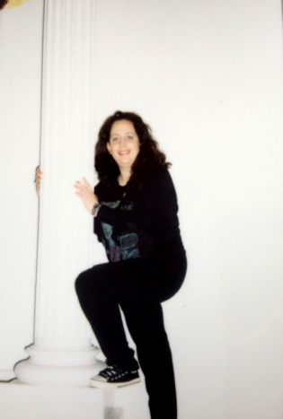
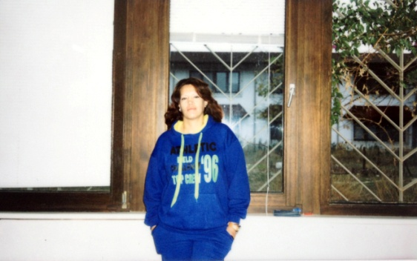
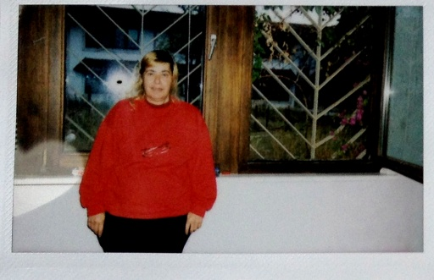
SELF - PORTRAIT
The group was asked to make a photographic portrait of themselves. They were in control of the whole process. They were the ones that would choose were to pose, how to pose and when to push the button. The photographs were then printed with a portable small printer
New Insights:
"I see myself submissive, as if I have lost my naturalness”
“Looking at my portrait, I can see how prison has changed me”

Slide 10
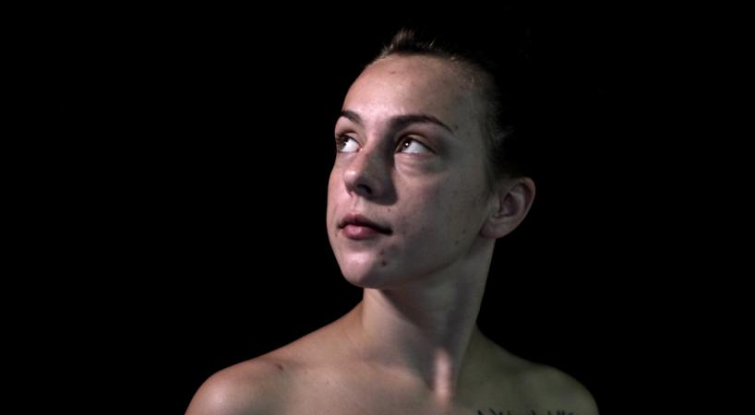
“Looking towards the light”
“The key to using these tools in a successful manner is allowing for self-confrontation”
(Henry, 1984)

Slide 11
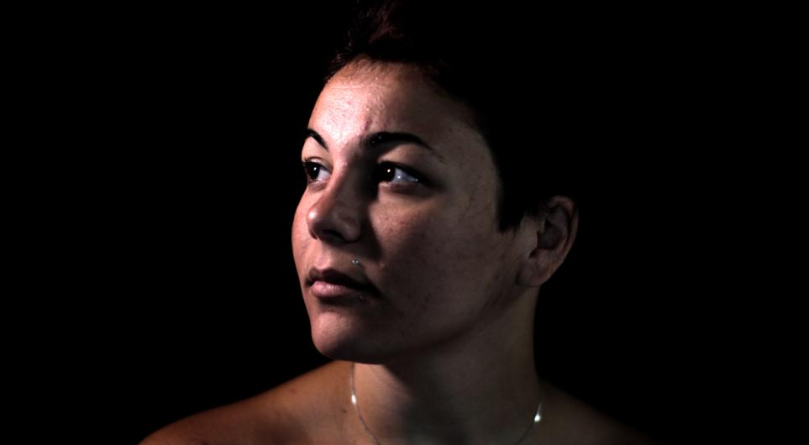

Slide 12
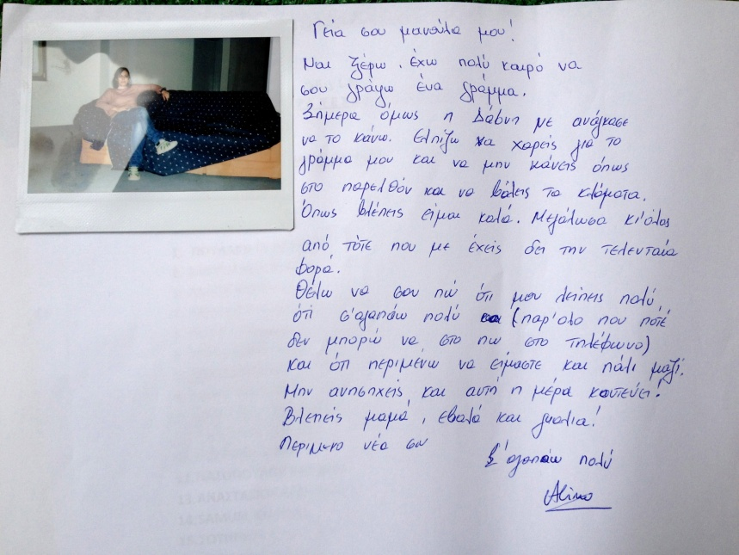
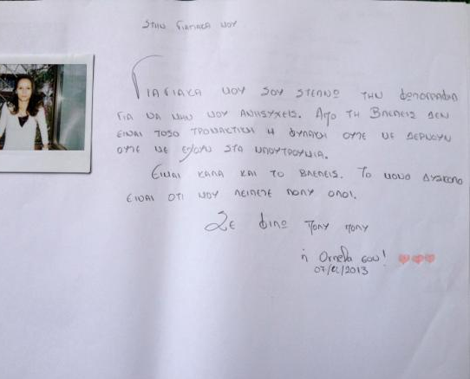
“Letter to a Significant Other”

Slide 13
“Dear Grandmother. I am sending you this photo so as not to worry about me. As you can see, prison is not soÂ frightening, nor have they locked me in dungeons. I am doing ok, and you can see this! The most difficult thing is that I miss you all so much. Many many kisses.
“My loves, my sweets.I may be surrounded by many railings and heavy doors. But the images of my eyes and soul are not imprisoned. I am always with you. My dreams are still alive!”
“Sweet Mummy, I took this photo so you can look at me till I come back. I love you very much. Your daughter”

Slide 14
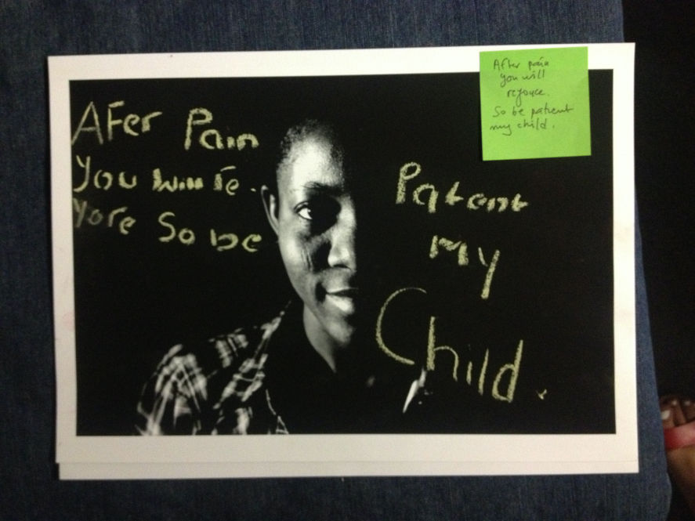
“Light and Darkness”
The group was asked to take a series of portraits around the concept of Light and Dark and reflect on them.
“After pain you will rejoice ..So be patient my child”
“Whatever doesn't kill you, makes you stronger”
“You live, you learn, you suffer, you die”

Slide 15
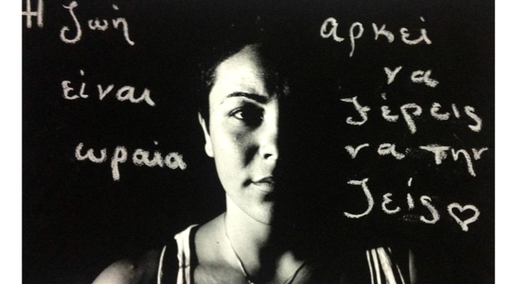
The writing exercise naturally flowed into a group conversation. While only two participants elected to share their artwork, the remaining individuals remained engaged. In closing, participants were asked to share a feeling word in summation of their experience in the group.

Slide 16
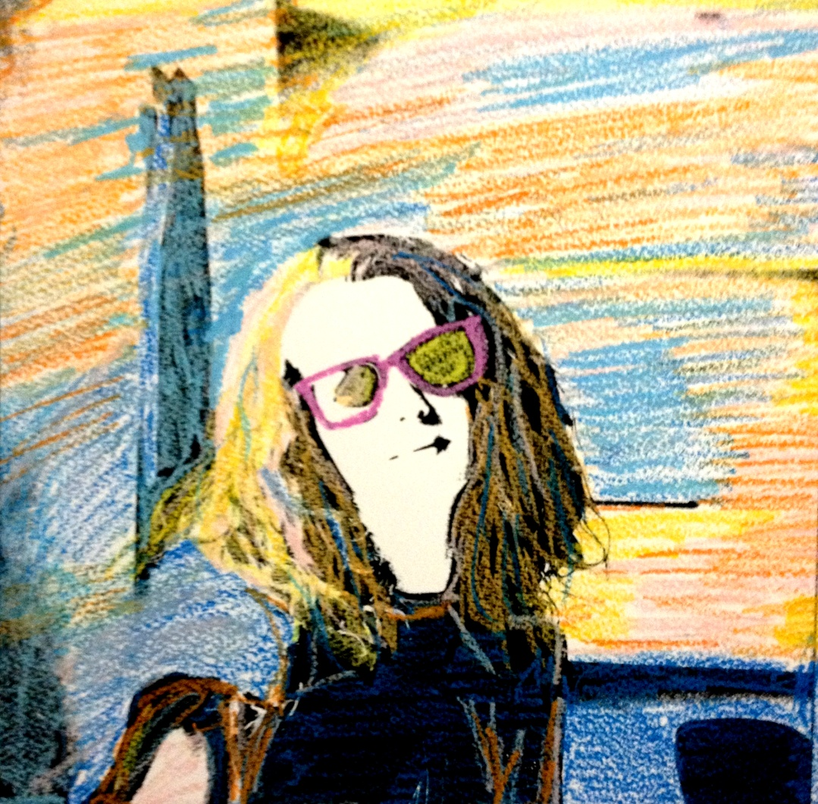
Photo-Art-Therapy
provided additional in- sights
the "art-part" added extra signifi- cance to the process

Slide 17
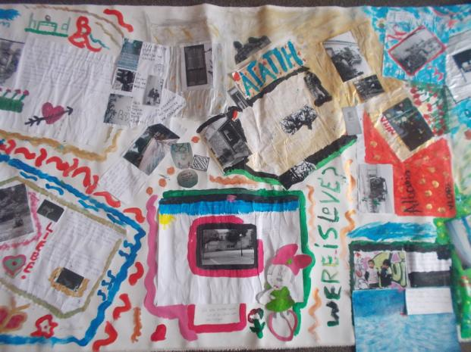
“Group Art-Work"
Subsequent art-photo therapy interventions developed from simple to complex and from individual art tasks to more interactive group projects.
The main goal was to gain insight into their interpersonal relationships
and the nature of connection between Self and Other through the creation of a group artwork

Slide 18
The following themes emerged from the discussion:
inevitability and importance of connection
tendency to isolate within the correctional environment
connection to Self
connection to nature
connection to others by proximity, familial bonds, and/or commonality of experience
connection and disconnection with staff members
and the power of art therapy to elicit connection.
Throughout the session and especially during art-making, participants began to reminisce about positive and enjoyable experiences they had recalled from prior treatment settings with staff and peers. Participants also began naming personal accomplishments and pleasant memories from prior treatment experiences.

Slide 19
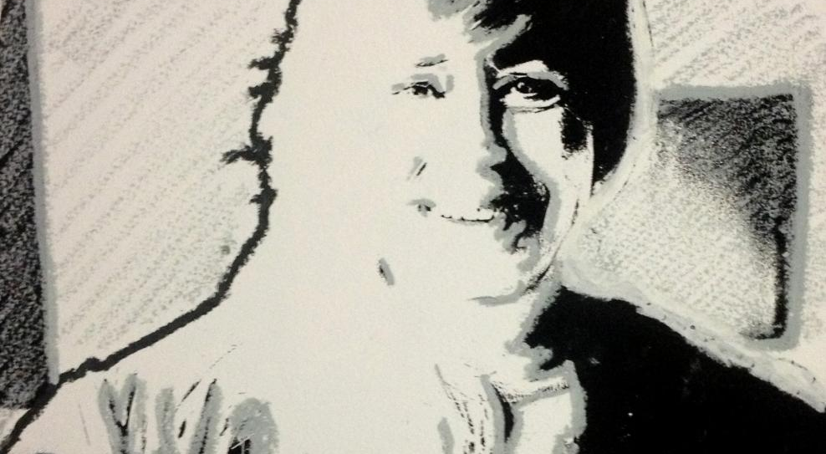
“Self-Image”
Participants were asked to take a self-portrait photo in an emotional state or capture an external event that evokes specific emotions for them.
This activity was followed by group discussion and exploration of the emotions that were expressed in the pictures, their meaning and the connection with external experiences.

Slide 20
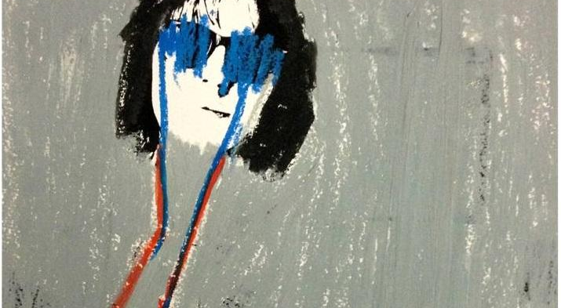
Specific themes that pop up were sadness, pain, trauma, anxiety, isolation.
Overall, this activity enhanced the understanding of the connection between external experiences, their internal emotional experiences, and their internal cognitions.

Slide 21
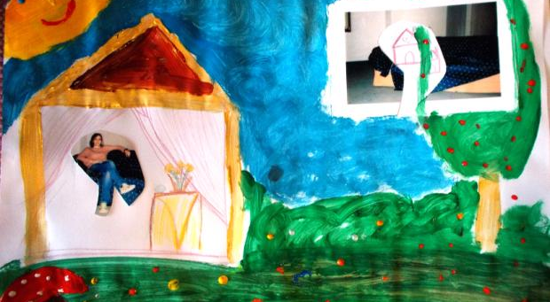
"Cut the image and put it in another context"

Slide 22

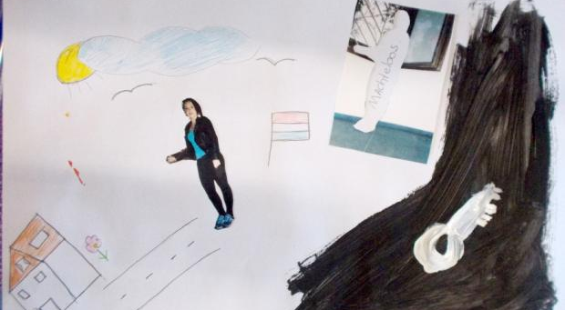
How the context of Prison influences inmate behaviour, personality and Self-Image.
This activity elicited discussions about the kind of view one has of the world from within prison walls

Slide 23
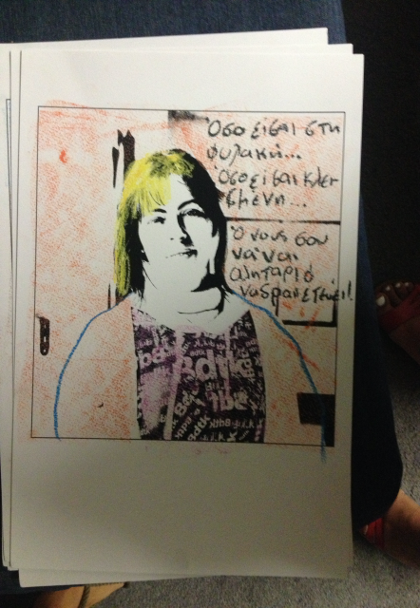
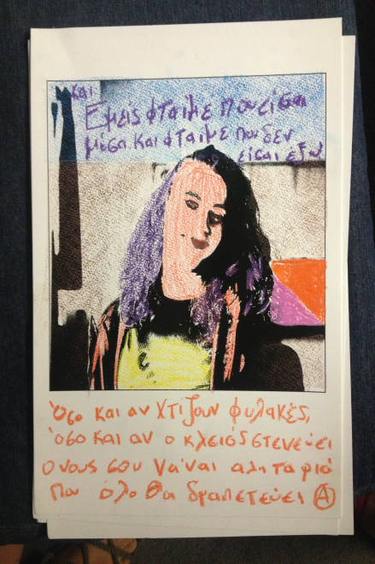
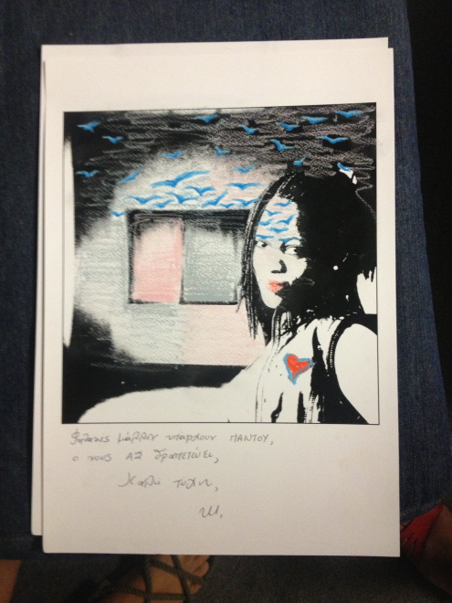
“Activity Portrets Inside-Out”
The intended impact of the activity was to develop a sense of attunement with the inmates and
their experiences of isolation, disconnection, and the reach toward community, empathy and hope.

Slide 24
Some quotes from participants about the program:
“I found the sessions really helpful and I think pictures are really a nice way of working, being able to show someone what you have in mind”
"Pictures help you visualize your thoughts and emotions and explain much better than words, things that might be hard to express otherwise”
“Photographs helped me overcome my initial shyness”
“Time really flies through these sessions and this is a big help when time is something you have a lot”
“Art allows me to relax, something that is difficult to happen in a place like prison, where you always have to be alert and vigilant”
“I forget the time and I feel more relaxed after the sessions”
“For me as a prisoner, this workshop is not only fun and refreshing, but it is also a form of freedom”

Slide 25
IO1- Good Practice of Thiva 102km
The medium of photography and the created image are seen as a source of new knowledge and dialogue that help participants to communicate with the group. The workshop provides a safe and supportive environment for participants to take risks, therefore it allows experimentation and trying out new behaviors which in return, enhance social skills.

Slide 26
REFERENCES
Barbee, M. (2002). A visual‐narrative approach to understanding transsexual identity. Art Therapy: Journal of the American Art Therapy Association, 19(2), 53–61.
Belkofer, C., & McNutt, J. (2011). Understanding social media culture and its ethical challengesfor art therapists. Art Therapy: Journal of the American Art Therapy Association, 28(4), pp. 159–164.
Breiner, M., Tuomisto, L., Beuyea, E., Gussak, D., & Aufderheide, D. (2011). Creating an art therapy anger management (ATAM) protocol for male inmates through a collaborative relationship. International Journal of Offender Therapy and Comparative Criminology, 56(7), 1124–1143.
Canter, D. S. (1987). The therapeutic effects of combining Apple Macintosh computers and creativity software in art therapy sessions. American Journal of Art Therapy, 4(1), 17–26.
Corbit, I. & Fryrear, J. (1992). Photo art therapy: A Jungian perspective. Springfield, IL: Charles C. Thomas.
Cox, C., & Cohen, R. (1995). Telling without talking. New York: W.W. Norton & Company.
Estep, M. (1995). To soothe oneself: Art therapy with a woman recovering from incest. American Journal of Art Therapy, 34, 9-18.

