Slide 1
O1- Different Ways of Using Art Therapy with Marginalized, Vulnerable Social Groups

Slide 2
Antropos Mental Hygiene Association
The Antropos Mental Hygiene Association (Antropos Mentálhigiéné Egyesület) was founded in 2010 with the collaboration of mental health professionals. It became clear to the founders that young people are the population that is most neglected in terms of mental health, while they are the most sensitive and vulnerable generation, and at the same time, they are also the most receptive to novelties.
We are responsible for the prevention of contemporary aggression, and the organization of individual and group consultation, psychotherapy (psychodrama, self-knowledge groups), psychological workshops, self-reinforcing trainings, lectures, films, performances and grandstands on mental health.

Slide 3
The relationship between the association and art therapy
Between 2019-2020, our specialists combined drug prevention with tale therapy, since with the help of tales we not only receive and give a guide to life, but they also support the participants of the workshops.
Our target group in the narrower sense in the field of health promotion and drug prevention is the 12-19 age group.
In our prevention work, we combine two tale therapy methods: the Treasure Hunt Tale Therapy Method and the Metamorphosis Tale Therapy Method.
The Metamorphosis Tale Therapy Method has two guidelines: the clinical and the creative-developing tale therapy.
In our prevention work, we mostly use the creative-developing method. The use of creative-developmental tale therapy is suitable in the field of prevention and personality development, to improve the quality of everyday life.

Slide 4
Why tales?
Through tales, we can gain valid knowledge about how the world works and what life tasks a person has.
The language of the tale is also suitable for adolescents to face problems that they (parents, guardians, caretakers) try in vain to explain to them. The tale practically presents a coping strategy that they learn to use.
The tale takes its listener to a “place” where he/she rarely goes: into the unconscious, into the realm of primordial images, therefore, immersion itself has a liberating force.
Everything we learn or experience through stories is much better remembered than the elements of knowledge that we have ingrained or was beaten in to our heads. One of the reasons for this is that stories always target emotions, with such force that it is difficult to withdraw from the influence of a fairy tale.

Slide 5
How we choose a tale for the sessions?
The most important aspect when choosing a tale is the knowledge of the target group, to whom and for what age the tale is intended, and what is our goal with the tale, of which, we build the tale workshop session around it.
In our experience, in the upper grades of primary school (12-15 years) we appeal to the passionate search for truth arising from their age, the difficulties of adolescence, and we offer them tales in which they are answered.
When choosing the type of fairy tale, the focus is actually, on which area we want to develop. After defining the area to be developed, the specific tale must be selected from the given tale group. Then, with the help of the storytelling guide technique of the Metamorphosis Tale Therapy Method, we make sure that our choice is right for the purpose.

Slide 6
Structure of tale therapy workshops
Until now, group tale therapy workshops have been organized and conducted for primary prevention. In the design of these workshops, we use the form used by the Metamorphosis Tale Therapy Method mentioned above.
After clarifying the goal, the target group, and the adequate choice of fairy tales, the fairytale workshop consists of the following elements:
- Entering the tale space
- Tuning in to the tale
- „Live word” story telling
- Questions about the tale
- Game, activities, tasks following the tale
- Exiting the tale space

Slide 7
Target group pattern | Tale pattern
High school life, choices, coercive decisions, curiosity, desire to belong to a peer group, difficult to overcome the age crisis, due to which the drug is likely to be tried or possibly used recurrently: | Tales, motifs, fairy tale pictures:
- Curiosity due to age - Apathy, disinterest - The need to belong to an age group - Emotional neglect - Identity crisis - Hopelessness/bleakness - Parental absence and/or abusive parental relationship - Lack of parental positive behavior patterns - Border situation: no longer a child, but not yet an adult Pushing self boundaries and/or disrespecting them Danger-seeking attitude | restoring the disturbed balance illustration of different types of soaring: from persecution to happiness motif of making your own wings longing for home unsupportive, frustrating environment, experiencing or exceeding the experience of loss

Slide 8
Draft of the session
Target group: | High school students, ages 16-18, 8-10 people
Goal of the session: | Presentation of adaptive coping strategies, possibilities of coping with difficult life situations, finding one's own happiness
Chosen tale: | Lotilko's Wings (Tunguz-Siberian folk tale)
Planned time: | 45 minutes
Required tools: | pictures of birds, candle, Koshi, feather shaped colored papers, writing instruments
Entrance to the fairytale space (5 minutes): | Choosing one of the pictures of different flying birds that appeals to the person the most.
Introduction to the tale (5 minutes): | What comes to mind about the word flying?
Story telling (7 minutes): | I am reminded of a story about flying. Can I tell?

Slide 9
Processing (12 minutes): | Focus questions, of which we ask questions tailored to the current mood of the group: 1. What happens in this tale? 2. What is the conflict of this tale? 3. Why did Lotilko get into trouble? 4. What causes the tension in this tale? 5. What is at stake in the story? 6. Who or who are the helpers here? 7. Could it be otherwise? 8. Is there an opponent in the tale? Who is? 9. Is there an important sentence or scene that you would highlight?
Related activity (11 minutes): | They are given feather shaped papers on which are written what are the things that give them wings, that take them forward, that help them achieve their goals. Everyone writes as much as they want. We share these with each other.
Exit from the tale (5 minutes): | Workshop feedback. They can take their own feathers with them.

Slide 10
I introduced the story with the following sentence: I know a story in which flying and the wings needed to fly play an important role. Can I tell it?
This is the time to light the candle in the middle of the room, embedded in the shawl nest. Reminiscent of the old days, when people would gather around a fire and listen to the storyteller, who would tell stories and pass on to the next generation the experience of the previous generation in pictures.
After lighting the candle, I take out the Koshi and ring it a few times.

Slide 11
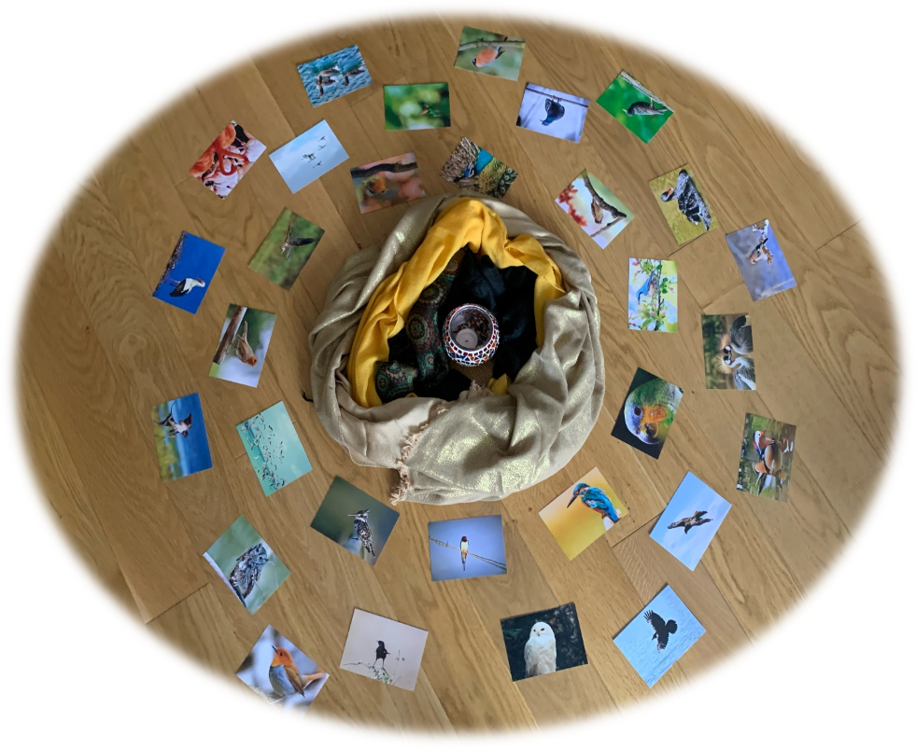

Slide 12


Slide 13
The Koshi is a high quality, authentic wind chime, handmade in the foothills of the Pyrenees. The wind chime is the result of meticulous and precise craftsmanship. This instrument was designed to invoke the four elements: Earth, Water, Fire and Wind. The sound of the Koshi is reminiscent of bells.
The wind chime is made by welding eight tuning rods with silver onto a metal plate, which is placed on the bottom of a resonant tube made of bamboo fibers, which is treated with natural oil. Precise tuning produces clear, richly overtones. The overtones of the shorter staves gradually dominate, creating a nice foundation, resulting in a harmonious sound.
With the Koshi's delicate string movement, the instrument's crystal clear relaxing tone is astonishing.
The function of using a Koshi is to facilitate and support the development of a story-listening trance, to start the alignment of the right and left hemisphere.

Slide 14
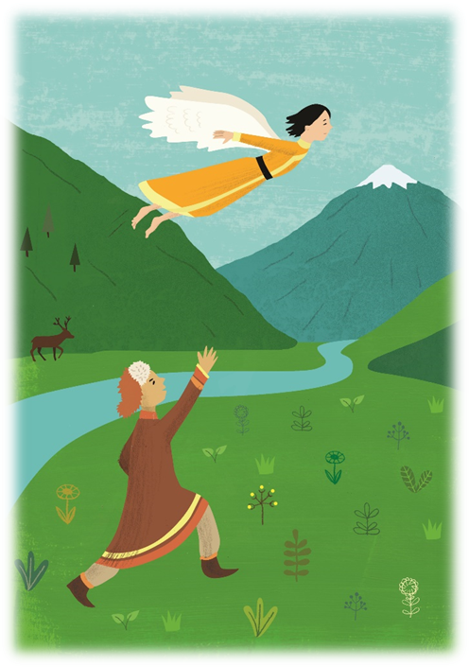
Lotilko’s Wings (Tunguz-Siberian folktale)

Slide 15
Lotilko was able to fly with his wings, which he made for himself and it has happened more than once that he has flown too far from his home. One day while flying, night has fallen on him, and he had to ask for accommodation in an unknown settlement. He found overnight accommodation at a man called Teventej. When Teventej saw Lotilko’s wings beside the bed, he got enraged and hid the wings. For days, Lotilko tried to find the wings, but in vain. No one helped him, because everyone was too afraid of Teventej. So he set out to collect bird feathers in the woods to make a new pair of wings. He was just attaching the wings to his shoulder when Teventej arrived from the hunt. Lotilko took off and went home. As Teventej watched Lotilko disappear in to the sky, he felt an irresistible desire to fly as high as Lotilko. He ran to the place where he hid Lotilko’s wings and put them on his shoulder. However, he could not lift off the ground. After this, he burned the wings, as he had no use for them.

