Slide 1
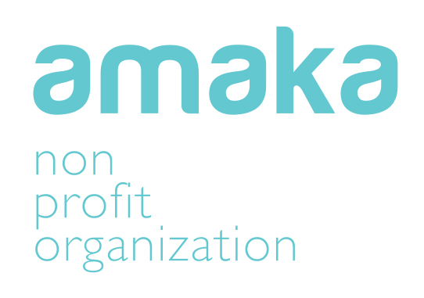
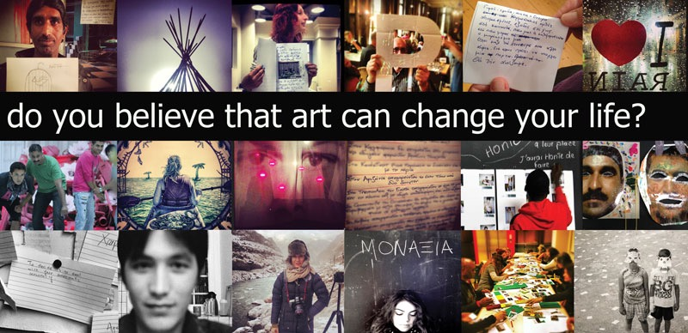
founded in 2008 in order to promote social inclusion
of vulnerable groups through the Arts

Slide 2

We believe that the arts are an excellent tool to promote :
Emotional well being
Social Change
Healthy Societies models
Integration of different social groups
Human Creativity and Imagination
Participatory Knowledge

Slide 3
So how do we use the ARTS?
We follow the ART THERAPY METHODOLOGY : Art Therapy is the use of expressive and artistic tools and techniques with therapeutic purposes. The artistic activity performed with therapeutic purposes, is geared to correct and manage problems, both psychologically and emotionally as well as socially. Its purpose exceeds the meaning of aesthetic result because the key in Art Therapy is the process used by the individual to contact his/ her inner world given that art is used as a language of non-verbal communication

Slide 4
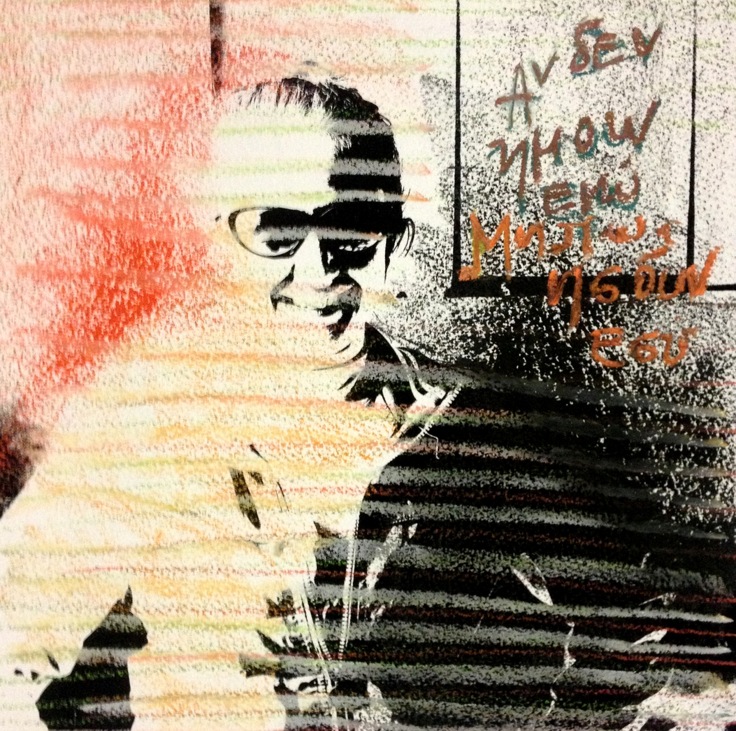
Arts Can Be Anything
Photography
Video
Dance/ Performance
Theatre
Painting/Drawing

Slide 5
Since 2008 Amaka has organized more that 50 different Art Therapy Projects for vulnerable groups at the city of Athens :
Refugees/ Immigrants
Homeless
Victims of Sex Trafficking/Sex Workers
Street children/ Roma
Drug Addicts
Children and Adults with special needs
Prisoners and families of prisoners

Slide 6
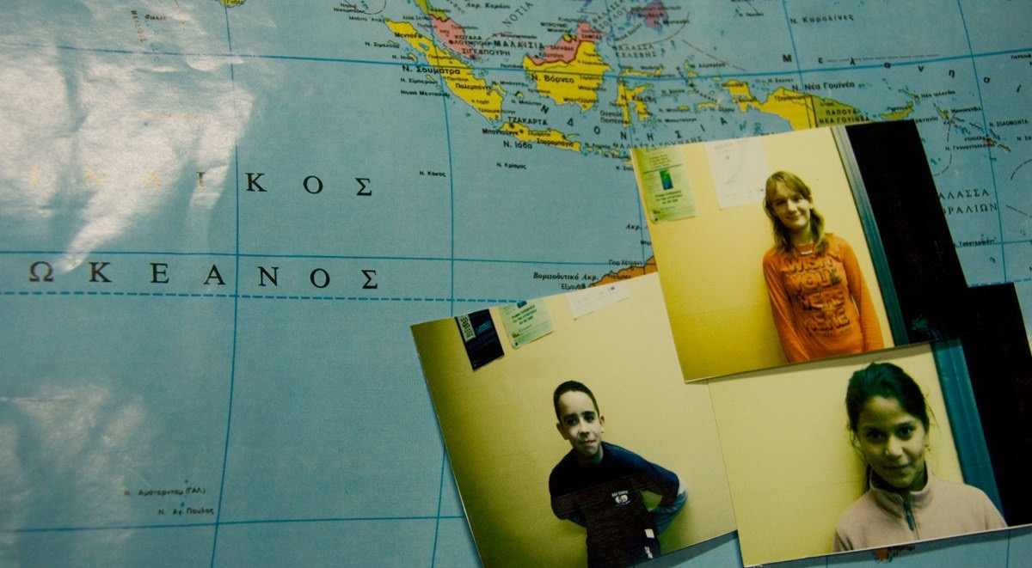
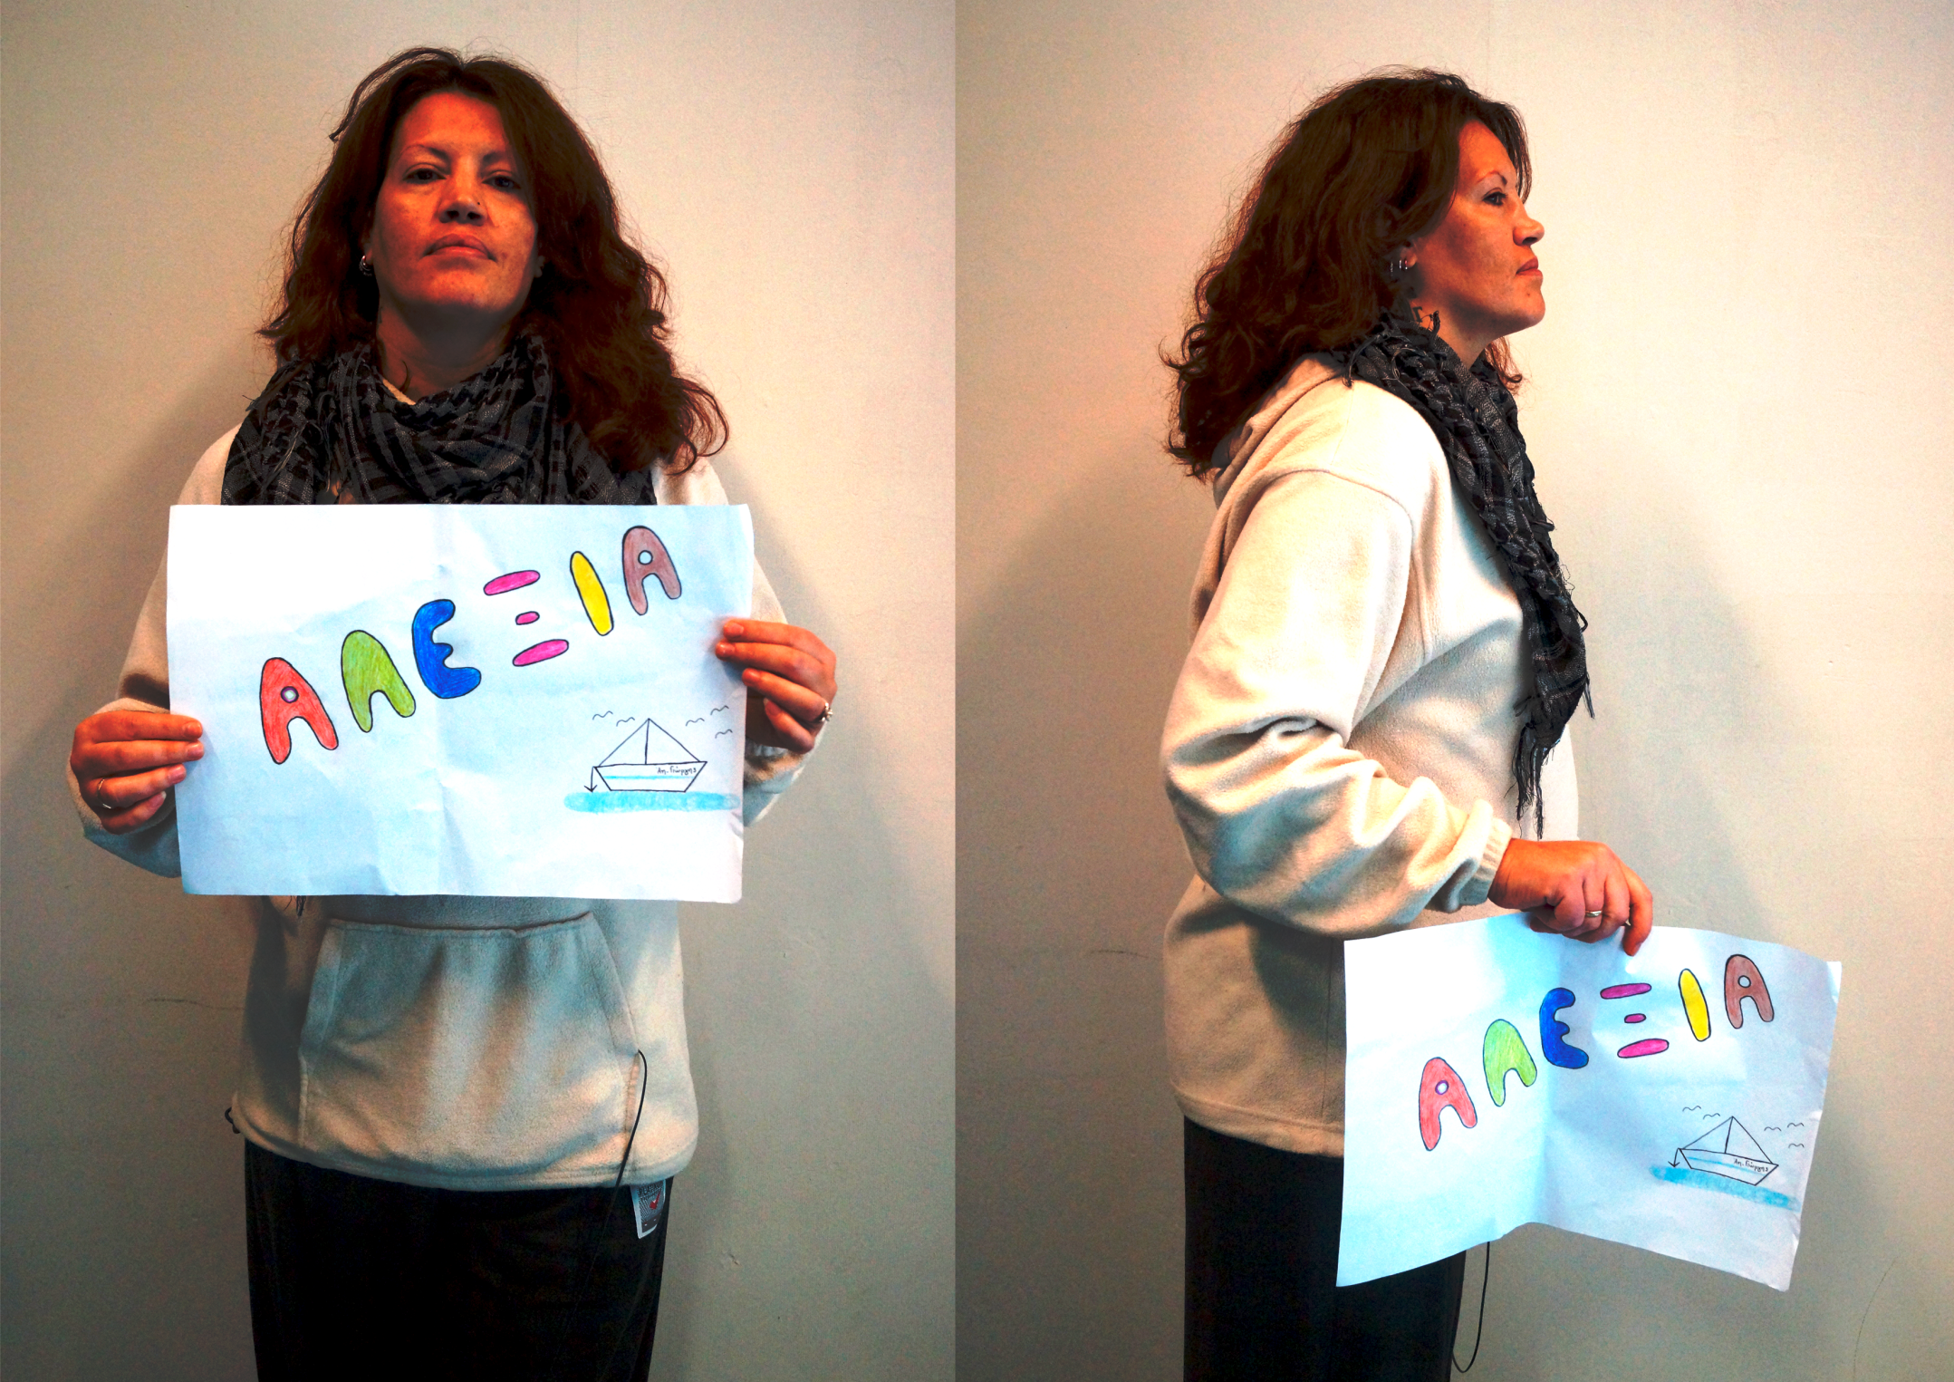
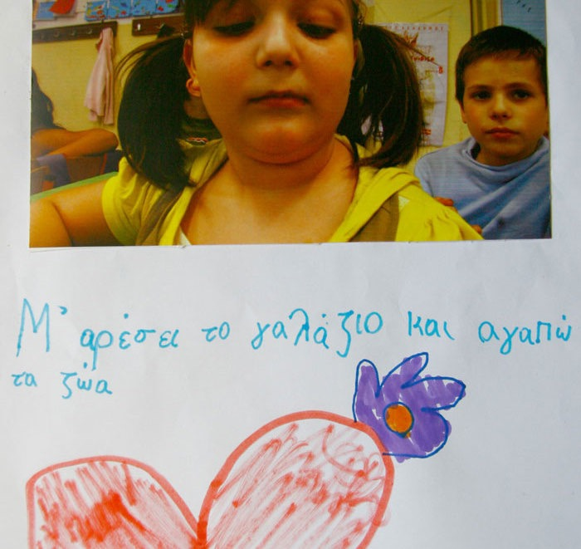
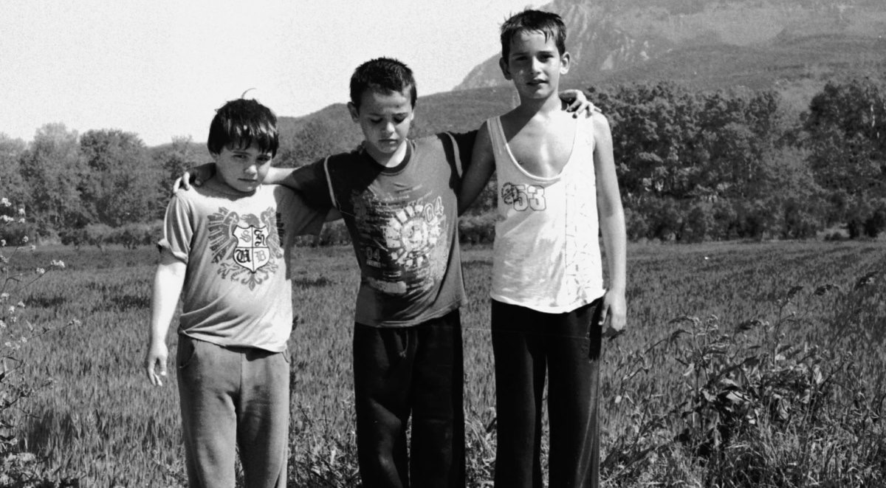
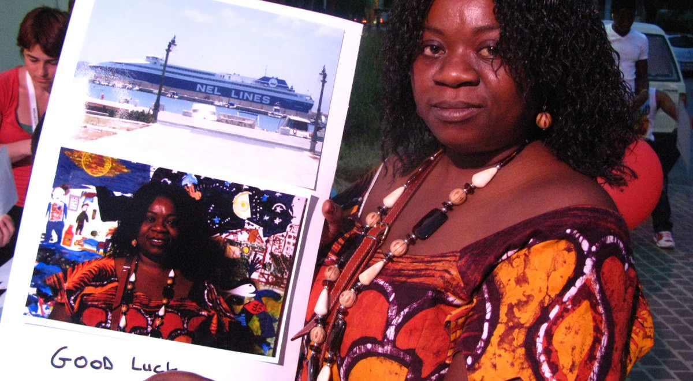
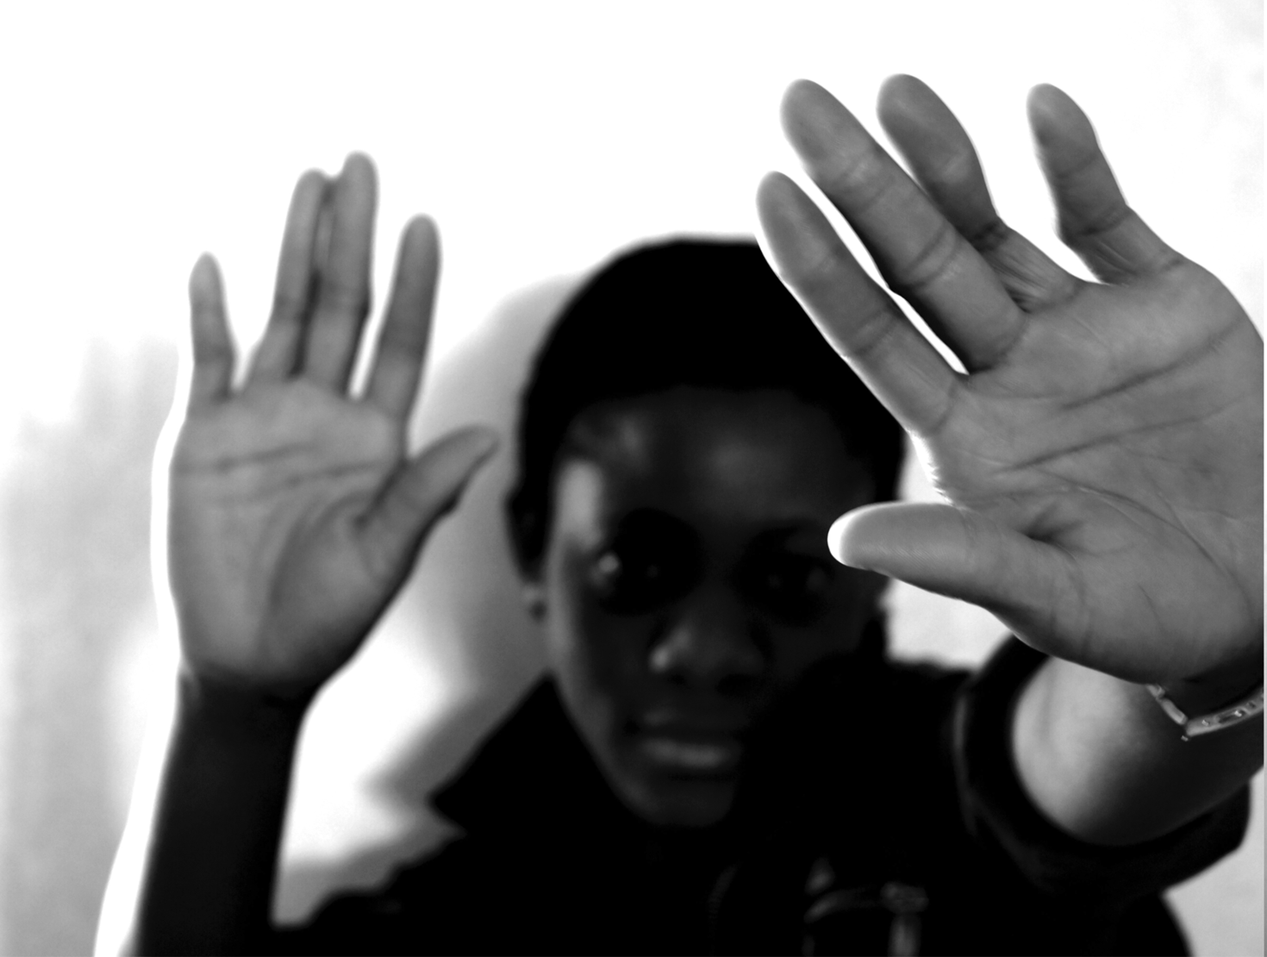
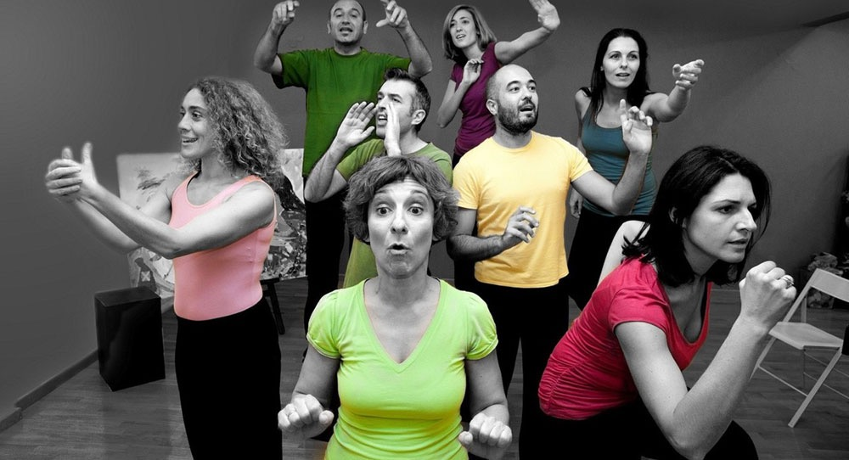
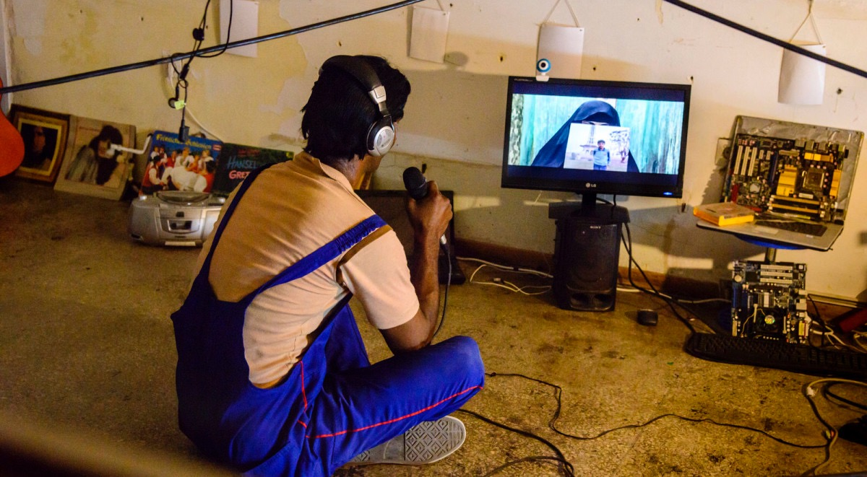

Slide 7
An Art Therapy Workshop is a multidisciplinary approach
Weekly closed Group Meetings
Theatre Plays
Photography- Art Exhibitions
Publications/ Research/ Conferences
Documentaries
Vocational Training
Intern Evaluations

Slide 8
HOW WE WORK ?
Project Based
Low Administrative Costs
Excellent Network of Collaborators
European and International Partnerships
Internships/ Volunteers

Slide 9
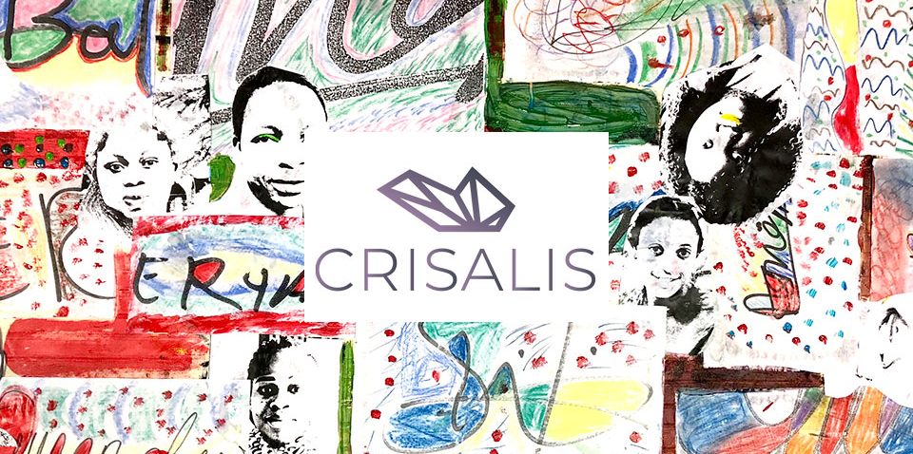
CRISALIS 2019
Phototherapy Workshop for Women victims of Sex-Trafficking
Caption

Slide 10
Crysalis is a program of trans-European cooperation, which aims at the social inclusion of abused women and the promotion of their financial independence.
Language Project collaborated with Makers Unite (Denmark) and Progetto Quid (Italy) for the implementation and design of the project
funded by the European Refugee Fund (AMIF)

Slide 11
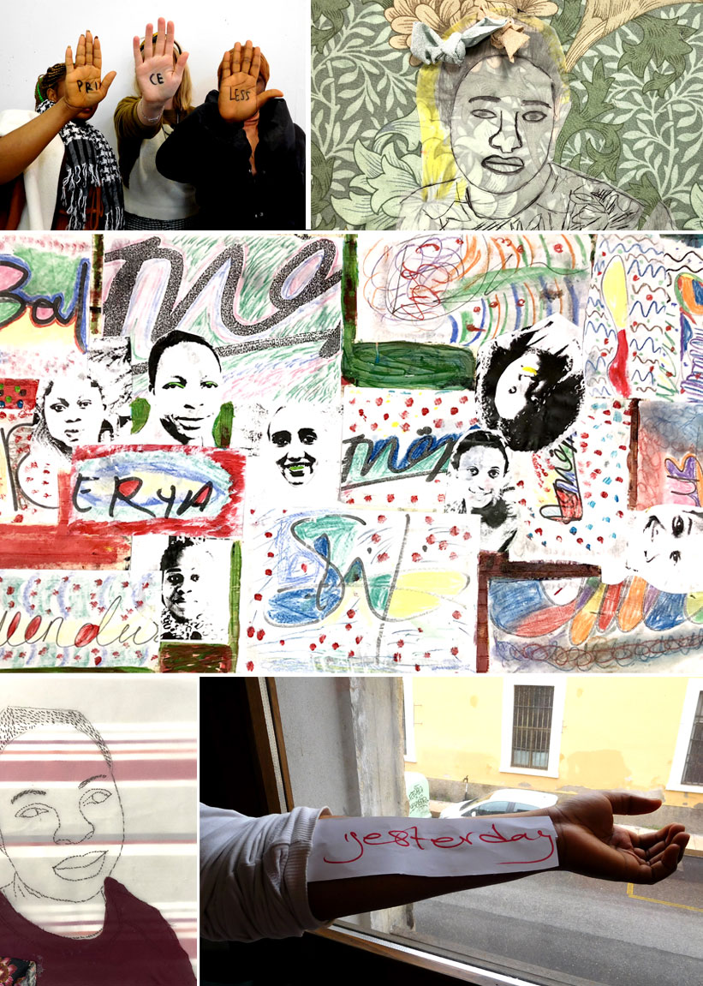
Crysalis
Five ladies experimented with Polaroid and digital cameras creating meaningful images and self-portraits expressing their thoughts and emotions by using visual language.

Slide 12
INTRODUCTION
Stage 1:
women were presented to the work of well-known photographers and a discussion followed around aesthetics and style.
Stage 2:
participants were asked to choose one of the photographs they have seen and mostly liked in order to present themselves through it.

Slide 13
ACTIVITIES
A) Creation of Polaroid self-portraits, which were then combined with text to help each participant express ideas and thoughts. The women talked about womanhood, self-worth, life and love while sharing life stories and experiences
Discussions around womanhood, self-worth, life and love
B) Creation of a Visual Alphabet “Alphabet of Appreciation”

Slide 14
“Alphabet of Appreciation”
Stage 1
The 26 letters of the alphabet were written on the board and the women came up with one word that starts from each letter. Words like Brave, Dedication, Rescue came up.
Leaving the group free to decide on the words with no given theme, the women were given the opportunity to talk about what mostly matters to them

Slide 15
“Alphabet of Appreciation”
Stage 2
After they decided on the words, they had to transform the words into images, by taking one picture depicting each word with the use of digital cameras. Women have experimented with movement, posing and framing in order to create symbols for each letter of the alphabet representing each word.

Slide 16
“Alphabet of Appreciation”
Stage 3
After creating the images, the photographs were printed on site. The last part of the workshop was the creation of the printed Alphabet with collage and mixed media methods and one artwork was created for each letter
The words chosen for each letter were: Amazing, Brave, Care, Dedication, Effort, Focus, Giving, Happy, Inspiration, Justice, Kindness, Love, Making, Nature, Opportunity, Peace, Question, Rescue, Sharing, Togetherness, Unity, Value, Worth, Zeal.

Slide 17
“Alphabet of Appreciation”
Stage 4
The compilation of the 26 letters was hanged on the wall to create what the women chose to call the Alphabet of Appreciation.
The making of the Alphabet brought the group together and helped in locating similarities in their life stories and experiences. In a way each of the participants made a statement on things that matter to each of them and the activity opened a ground for further discussion within the group.

Slide 18
“Leaving the space of Makers Unite in Amsterdam, we felt like leaving a more empowered and self-supportive group than the one we found same morning.”

