Slide 1


Váltó-sáv Alapítvány
Half-way Flat Program

Slide 2
Basic information:
2002 (1997)
INSIDE-OUTSIDE
National, civil, helping, professional
Target group: deviant, underpriviliged, marginalized, vulnerable, indangered groups – prisoners, released, relatives, majority society

Slide 3
Goals:
Social and labour market (re)integration of the target group
Helping work, helping relationship
Mental health care, support
Enhancement of coping capacity
Development of sel-helping skills
Training, education
To decrease prejudices, sensitization,
Streghtening social inclusivity
Resocialization/reintegration/rehabilitation-OUTSIDE

Slide 4
Methods:
Continous (after)care / „through care” (OUTSIDE)
Civil support system (mento, coach, helping relationship)
„principle of „several methods instead of one method”
with the toolkit of helping work (group, individual)
Complexity and sinergy of supportive and educational elements (training and education are methods too)
„pollination”
„drop in”
coaching, gamification, training, art therapy

Slide 5
Summary:
Accommodation (so-called half-way flat program 01.01.2010-31.03.2016, since 01.12.2019)
Work, job (Change Space, Váltó-sáv Information Base, job coaching, consultation)
training (13 licensed adult trainings)
Groups, trainings in penitentiaries
Social relationships (helping relationship, mentors, community program, family days, father groups, etc.)

Slide 6
Half-way House/Flat program
2005-2006 – feasibility study
Experience collecting
national: Tas-Alsószenttamás (Mécses Szeretetszolgálat), Boldogkerti Lakóotthon, Debrecen, Élő Reménység Alapítvány, Dunakeszi
foreign: Latvia (Riga), St. Pölten (Austria), Brandenburg (Germany) - later: Mienia (Poland), Alytus (Lithuania)

Slide 7
Half-way program: reasons
Complicated family relationships
Inadequate care system
No perspective
Being stuck somewhere
Permanently on the periphery for good
Another (forced) community (?)

Slide 8
2010-2016, 2019
Half-way flat (instead of house)
In a big city (Budapest, due to employment reasons)
In the 8th district (practical reasons)
High threshold service (cooperation with VSA, not a „free apartment”)
NOT a rehabilitation institution (reintegration)
Need and motivation for change
6 ppl/flat max
Short, few, strict, clear rules with consequences

Slide 9
Entry process
Leaflets, short film (spot), our own programs, webpage (Hungarian Prison Service, VSA)
Entry process: application: probation officer, letter
2 co-workers at least twice, and our own clients
A) informations, motivational discussion b) documents of the half-way flat (flat policy, cost plan, etc) c) questions
Motivation / need for change / possibility of cooperation / labour market (re)integration

Slide 10
Who can’t?
Ones who could be in reintegraion custody, if they had a acceptance statement
disabled
elders
Ones who before prison lived as homelesses for a long time, know the care system too well
Haven’t worked/got education/ participated in programs in the penitentiary
Ones who have special needs
Ones who don’t want to change/cooperate/have conditions

Slide 11
The first days…
Moving in, signing the contract
Weekly plan / weekly report
Cost plan (savings)
Planning the order of accommodation (cleaning/cooking/shopping/washing, etc.)
Leaving the flat in the morning: work or looking for a job
Administration (sometimes or for the first time together with a helper) – documents (ID card, address card, tax card, bank card, social security card, certificates, criminal record document, etc.)

Slide 12
Most common problems after release
missing documents
Missing certificates
No digital competence
No money
Total reality loss, loss of sense of time
Institutialization
No planning at all (ad hoc decisions)
Problems with communication skills)
Health problems (sedatives, etc.)

Slide 13
Days later…
Work + some kind of training or learning
Groups if needed (outside groups, new communities, relationships) – NOT A COMMUNITY!
Holidays together and/or joint preparations
Hiking, going out together (spontaniously or organized)
Every day one helper is on duty!

Slide 14
Basis of the professional program
Ensuring complex services: housing, human relations, labor market services, training / learning
psychosocial support and care (helping work) are given a prominent role
the living space must ensure a certain level of autonomy, personality, expression of individuality
shaping the free interior, keeping your own objects, etc. represent the value of freedom
the rules on community coexistence must also be complied with
developing the personalities and key and transversal competences of released prisoners
supporting their labor market skills and opportunities
organization of structured and semi-structured leisure programs
establishing the enforceability of restorative programs and special codes of conduct

Slide 15
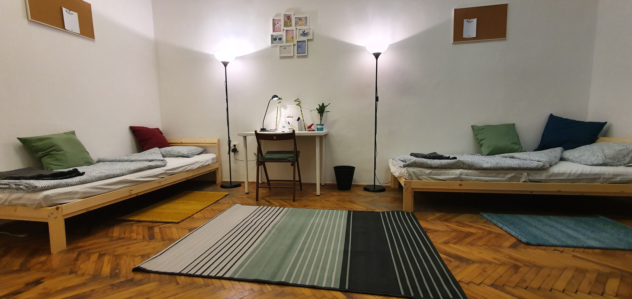
Everydays in pictures

Slide 16
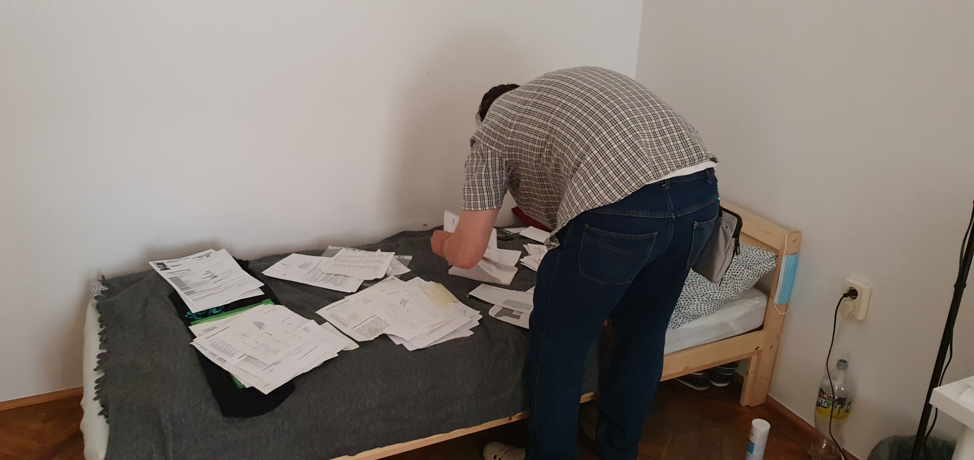
Everydays in pictures

Slide 17
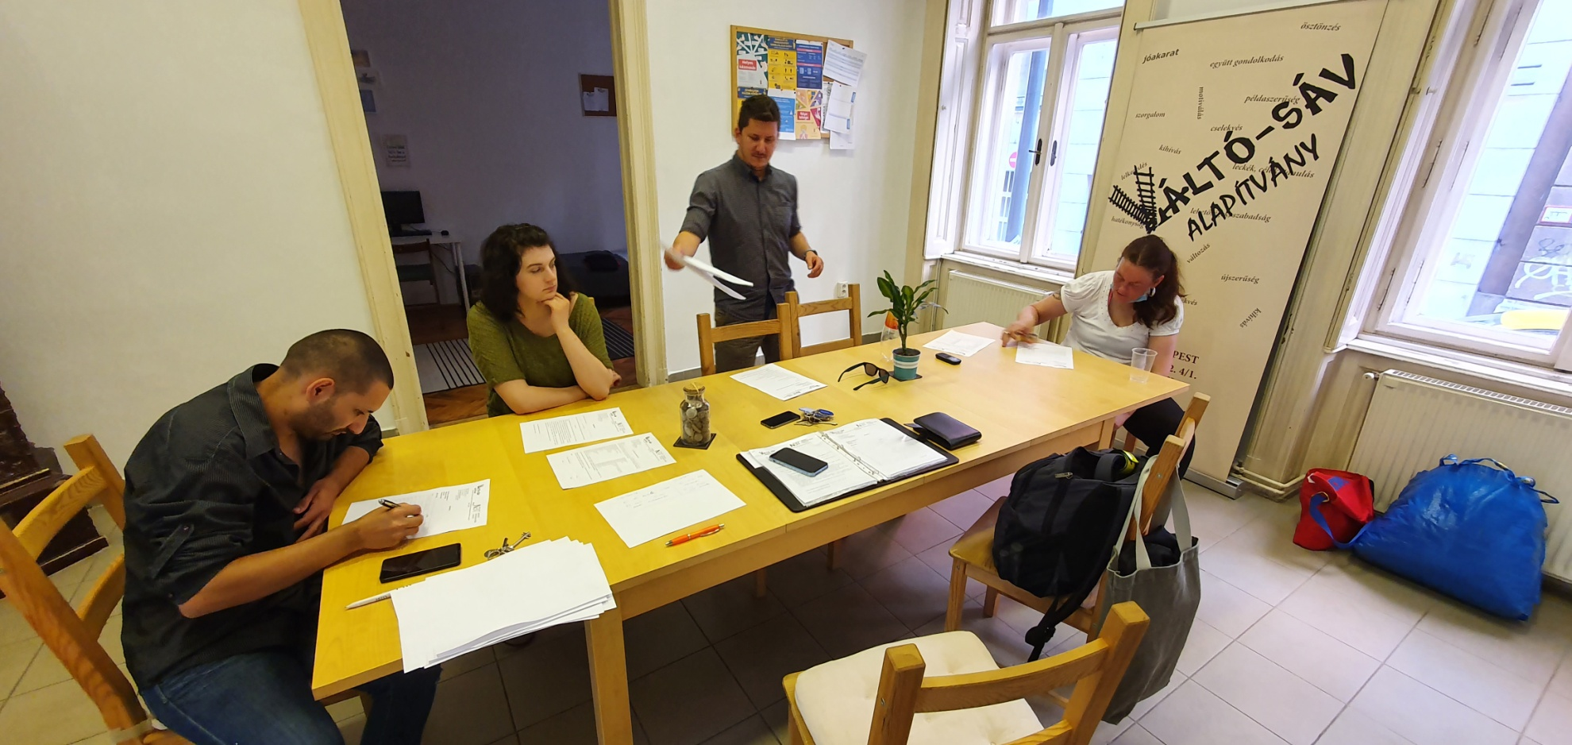
Everydays in pictures

Slide 18
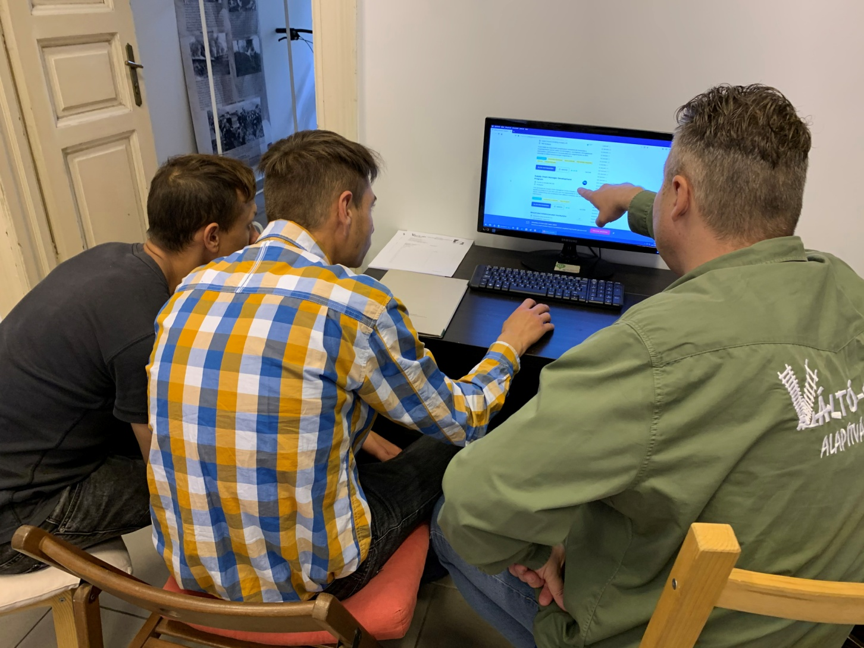
Everydays in pictures

Slide 19
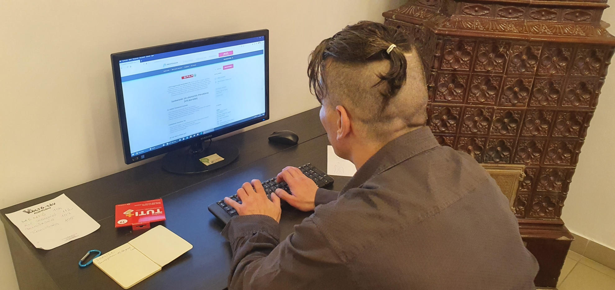
Everydays in pictures

Slide 20
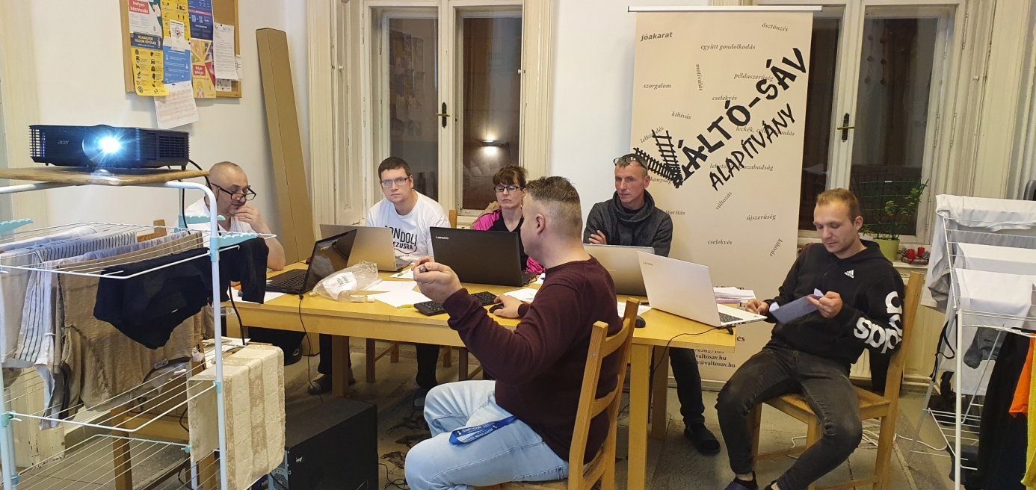
Everydays in pictures

Slide 21
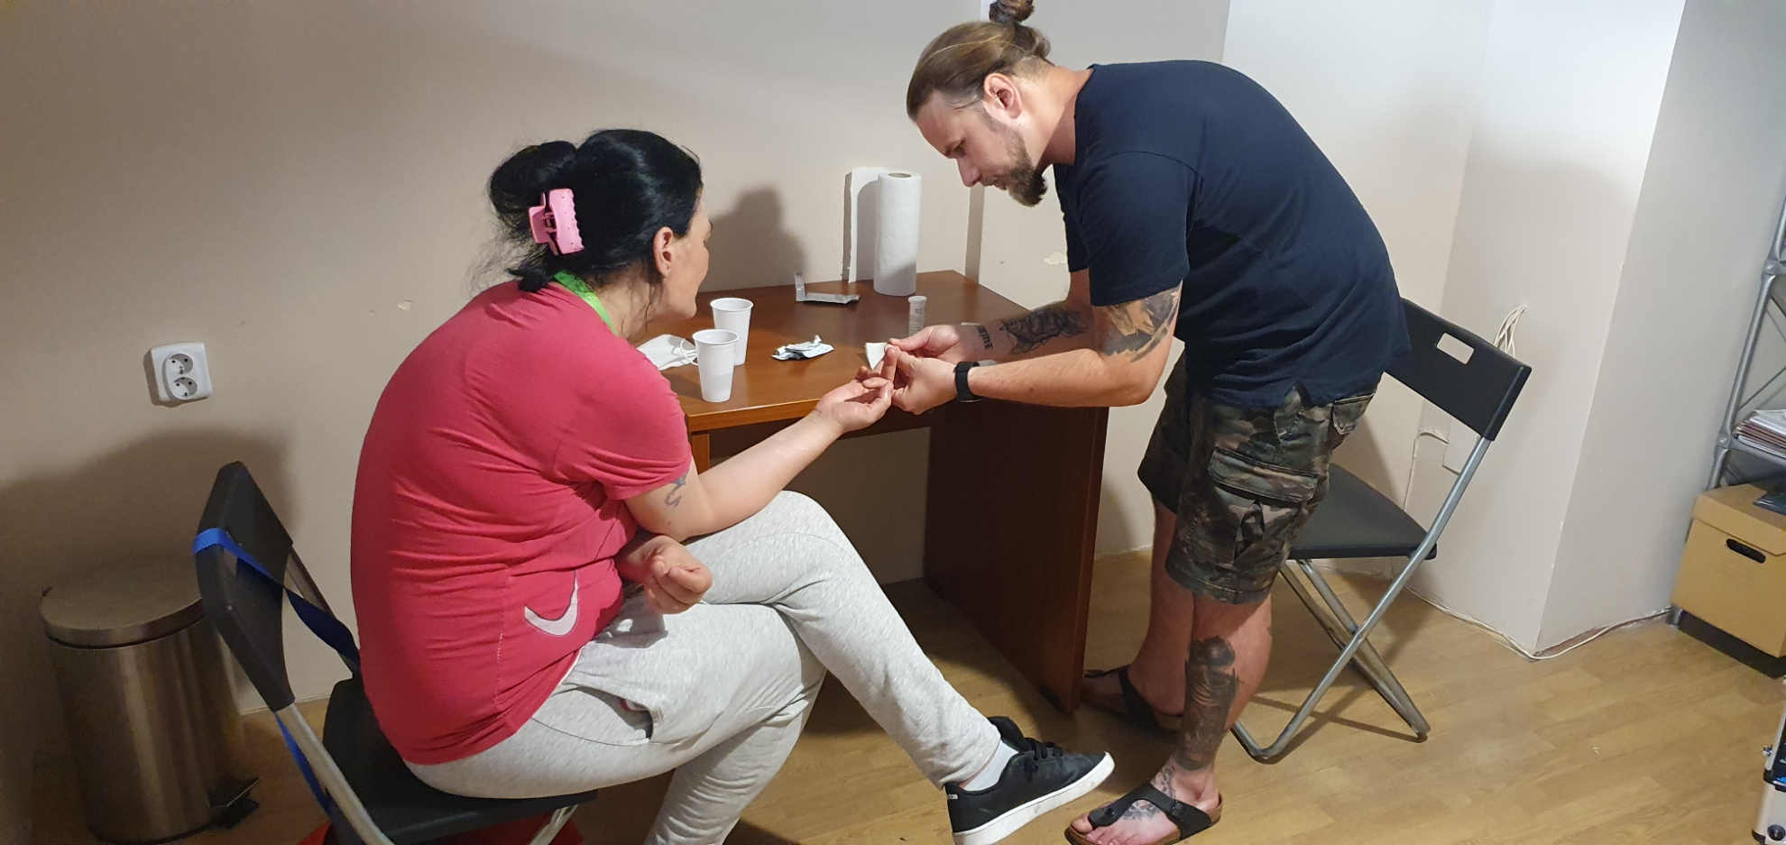
Everydays in pictures

Slide 22
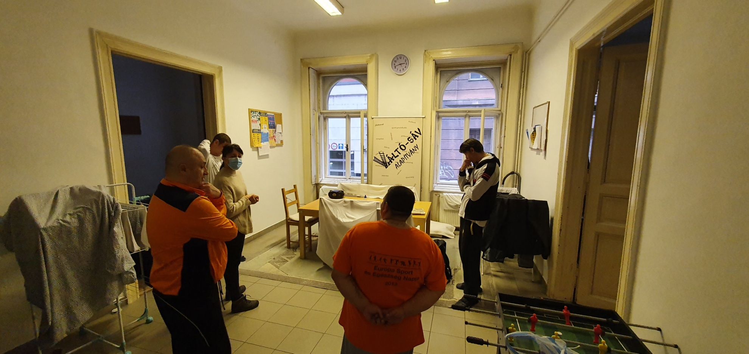
Everydays in pictures

Slide 23
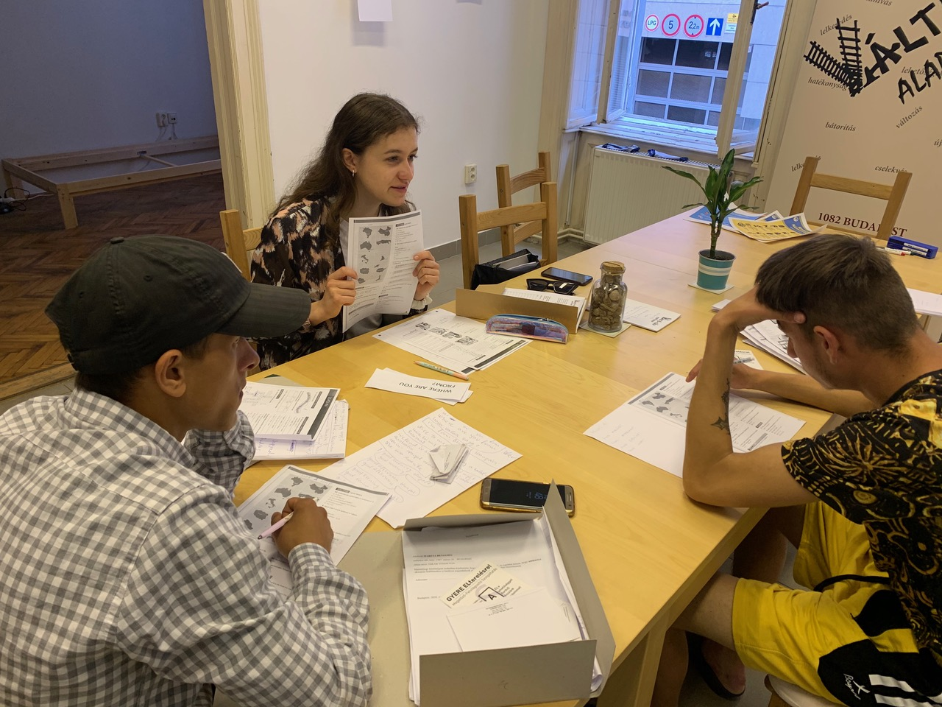
Everydays in pictures

Slide 24
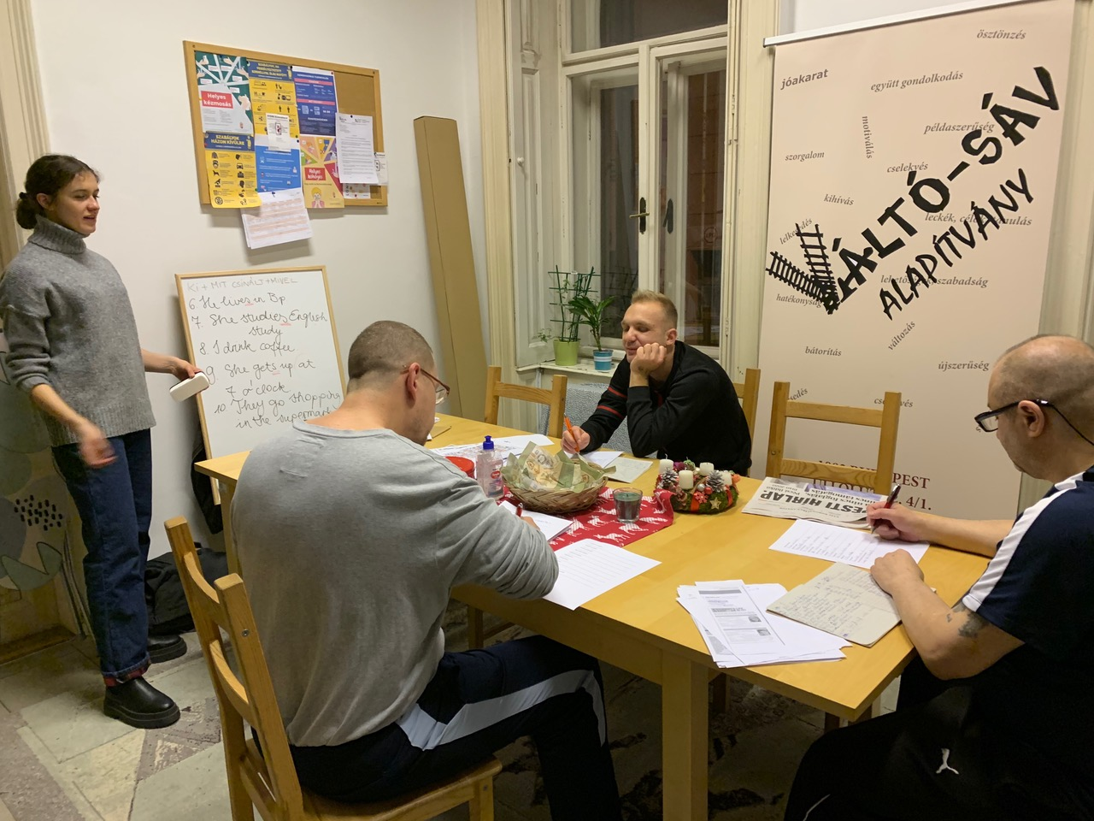
Everydays in pictures

Slide 25
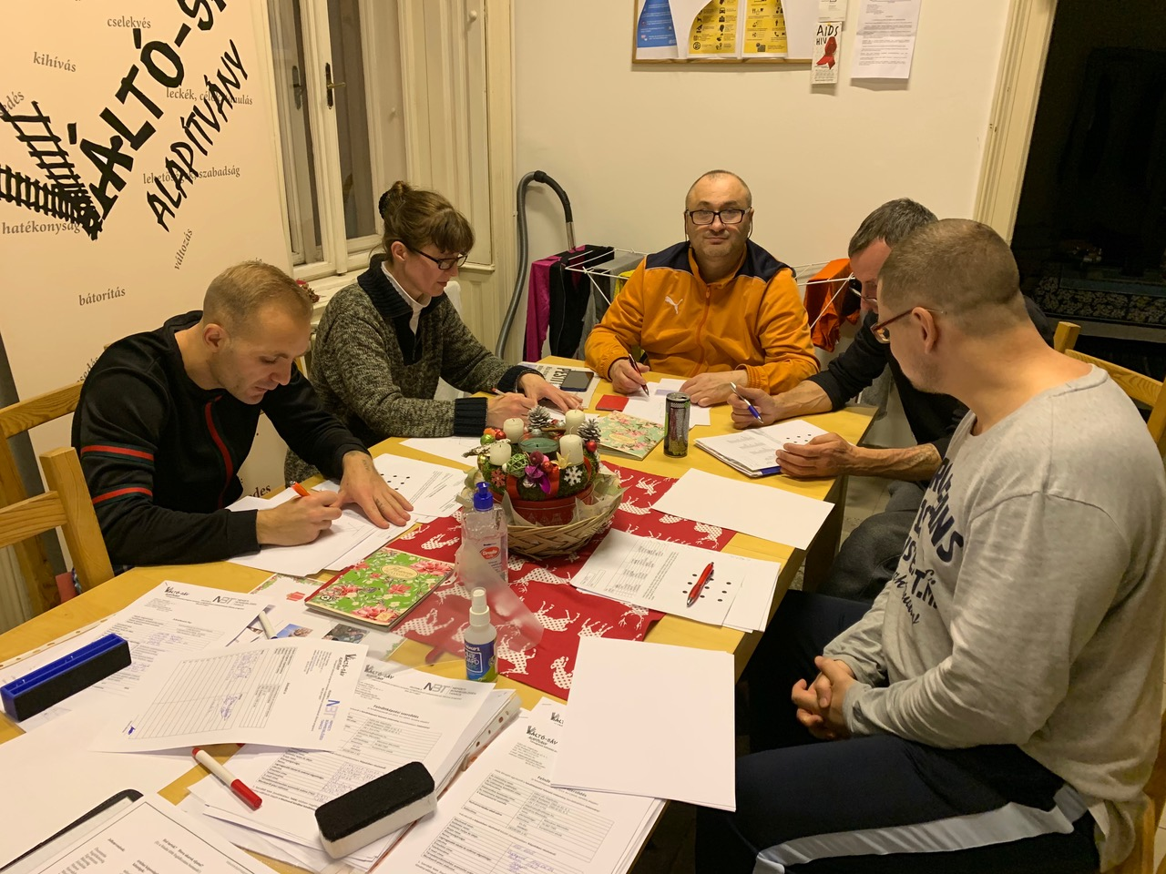
Everydays in pictures

Slide 26
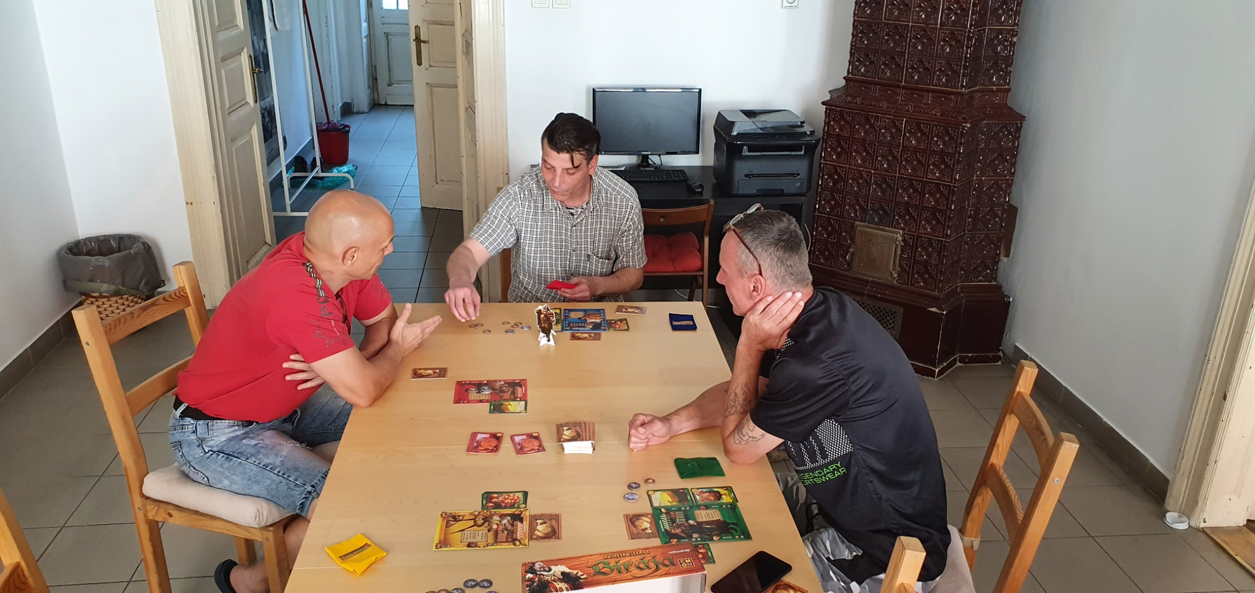
Everydays in pictures

Slide 27
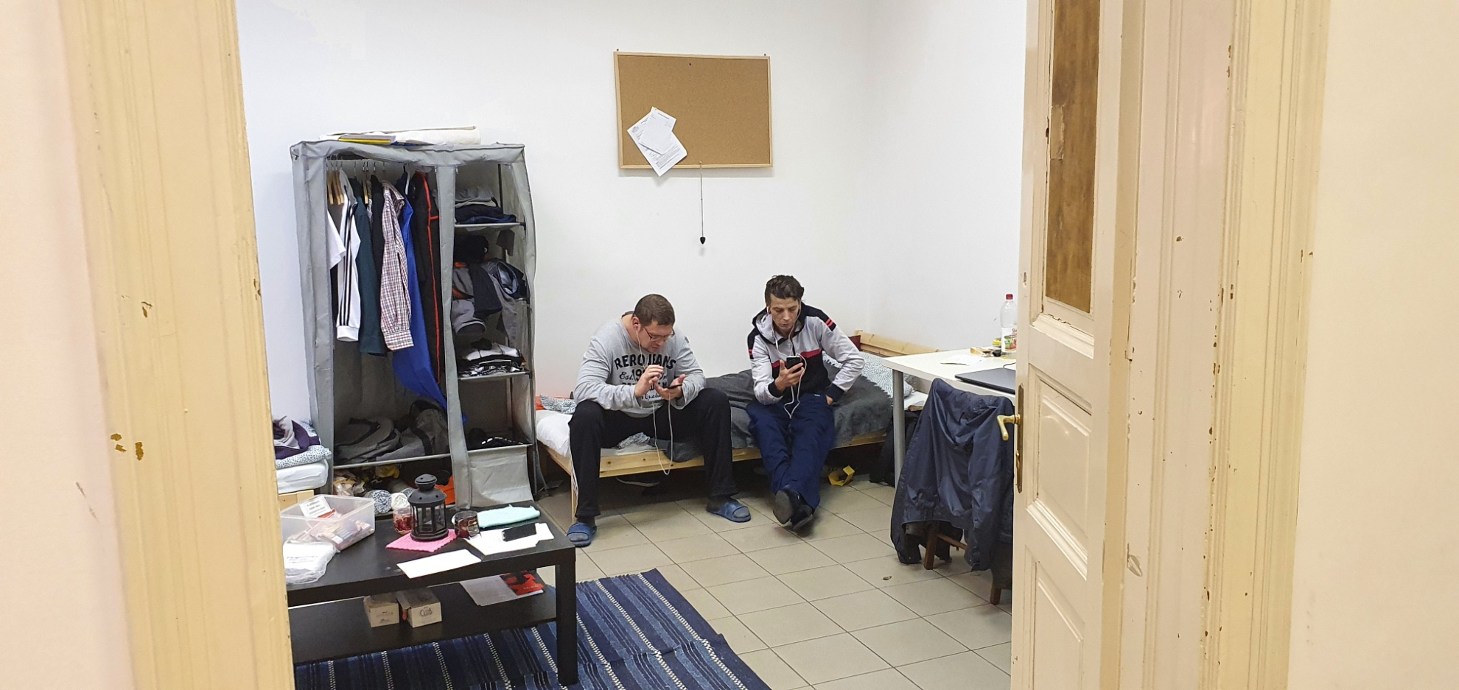
Everydays in pictures

Slide 28
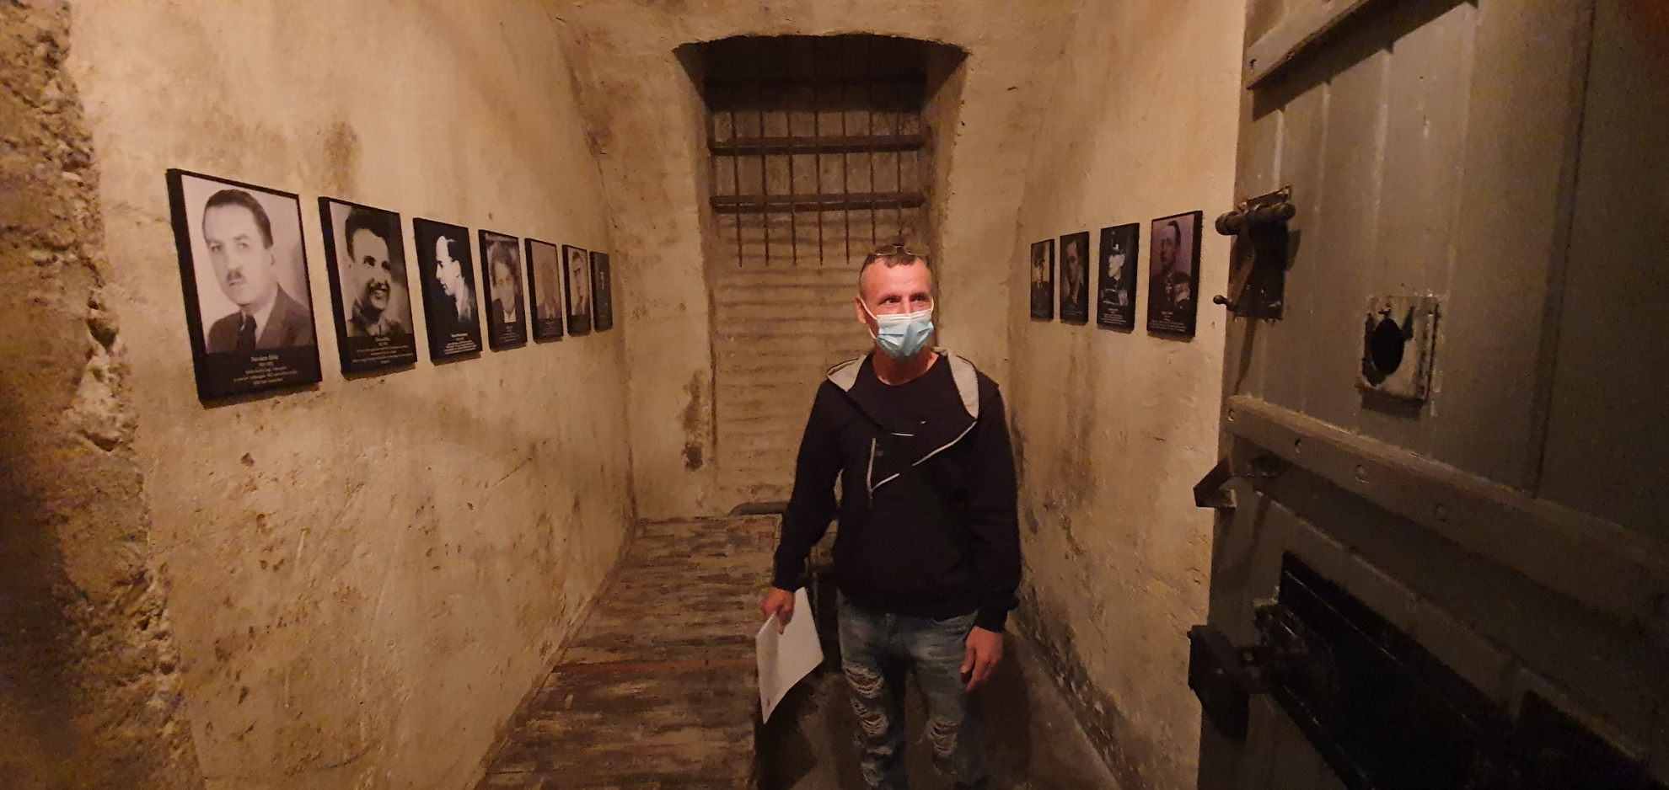
Everydays in pictures

Slide 29
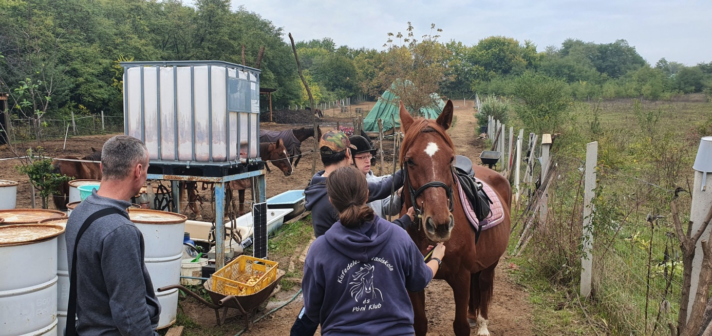
Everydays in pictures

Slide 30
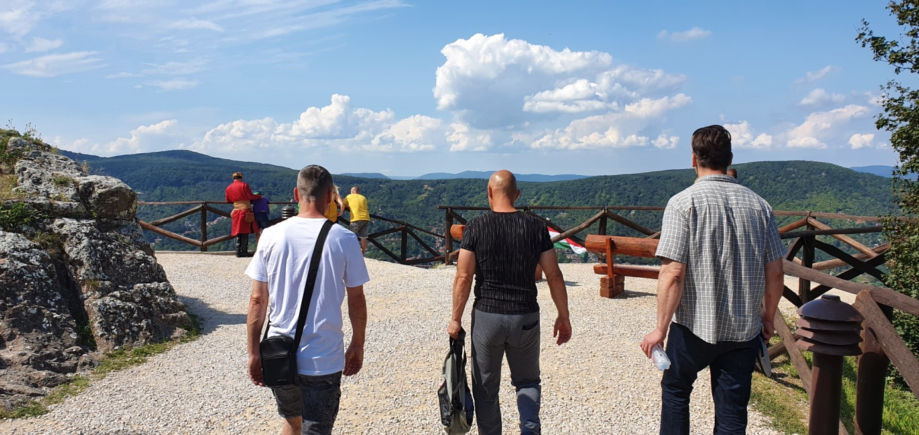
Thank you for your attention

Slide 31
Online:
Web: www.valtosav.hu
E-mail: alapitvany@valtosav.hu
Facebook: www.facebook.com/ValtosavAlapitvany/

